Slide 1
Why are Medicare Advantage plans overpaid?
Presentation to UMRA
May 8, 2023

Slide 2
Ten insurance companies control 78% of Medicare Advantage market (July 2020)
UnitedHealth Group
Humana
CVS Health Corp
Anthem
Centene
Cigna
Top ten: 78% of total
MedPAC, Report to Congress, March 2021, Table 12-3, p. 366 mar21_medpac_report_ch12_sec.pdf

Slide 3
Medicare Payment Advisory Commission: Insurance companies have never cut costs
“[P]rivate plans in the aggregate have never been paid less than FFS [fee-for-service] Medicare, due to policies that have explicitly elevated payments to MA above the FFS equivalent. As examples, MA benchmarks are set above FFS in many markets in part to encourage more uniform plan participation across the country, and quality payments (which the Commission has found do not meaningfully reflect plan quality…) further inflate MA payments above FFS. Moreover, MA plans’ diagnostic coding practices inflate payments….”
MedPAC, Report to Congress, March 2023, p. 323 MedPAC March 2023 Report to the Congress: Medicare Payment Policy

Slide 4
US GAO has told Congress repeatedly privatization raised Medicare’s costs
“Our review of studies on risk selection shows that, because most HMOs benefit from favorable selection (the healthier individuals typically enroll in HMOs), Medicare has paid HMOs more than it would have paid for the same patients’ care by fee-for-service providers. Estimates of the excess payments range from almost 6 percent to 28 percent.”
U.S. General Accounting Office, Growing Enrollment Adds Urgency to Fixing HMO Payment Problem, November 1995, 9.

Slide 5
Insurance company overhead costs dwarf Medicare’s and Medicaid’s
Administrative costs as a percent of expenditures:
Insurance companies, private sector 20%
Insurance companies in M-care and M-aid 15%
Medicaid (without insurance companies) 4-5%
Medicare (traditional program with no insurance companies) 1%

Slide 6
Medicare is the insurance industry’s golden goose: Gross margins per enrollee, 2021
Medicare Advantage $1,730
Medicaid $768
Private (group market) $689
Private (individual market) $745
“Gross margins per enrollee are the amount by which total premium income exceeds total claims costs, divided by the number of enrollees. Gross margins include administrative costs, tax liability, and profits.” Health Insurer Financial Performance in 2021 | KFF

Slide 7
Causes of Medicare Advantage overpayment
Factor causing overpayment Amount of overpayment (1) Favorable selection/deselection + bad risk adjustment 15% (2) Upcoding (after taking into account CMS's deflator) 5%
(3) “Quality” bonuses (3.5 or more “stars” out of 5) 3%
(4) County bonuses 5% * Net effect on overuse (-3%) and underuse (3%) 0%
Subtotal 28%
(5) Induced utilization 14%
Total overpayment 42%

Slide 8
Problem: HMO enrollees cost only 60% of TM average during 1980s and 1990s
“Spending by new HMO enrollees was only 63 percent of that for beneficiaries in the fee-for-service control group in the six months before they joined an HMO…. But this result hides significant differences between those who remained enrolled in the HMO and those who subsequently left. Beneficiaries who stayed had the lowest relative pre-enrollment expenditures of all the HMO enrollee groups, with total spending averaging only about 56 percent of the fee-for-service level.”
Note: Both favorable selection and deselection at work.
Physician Payment Review Commission, Annual Report to Congress, 1996, p 260. Data examined: July 1989-June 1994.

Slide 9
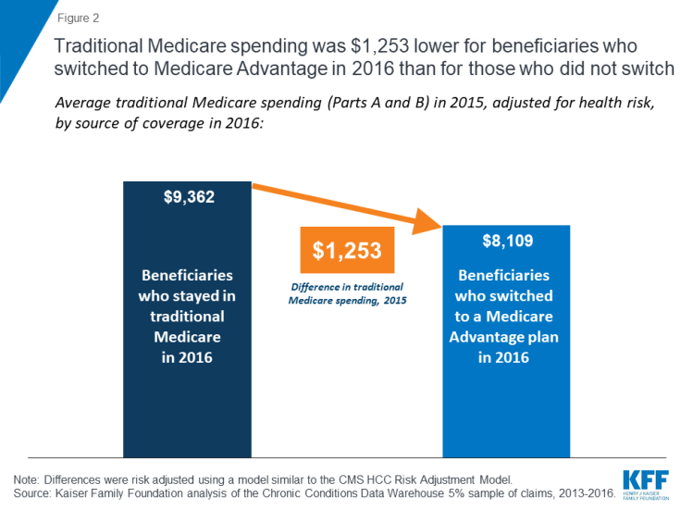
Latest evidence indicates MA enrollees cost 87% of cost of insuring TM beneficiaries

Slide 10
CMS’s “demographic” risk adjuster predicted 1% of variation in spending
Assume average cost of Medicare enrollee is $10,000 per year.
Assume HealthPartners enrolls beneficiaries averaging $9,000. Overpayment = $1,000.
CMS only subtracts 1% of the overpayment, or $10, and pays HealthPartners $9,990. HealthPartners is overpaid $990.

Slide 11
Upcoding became a problem in 2007

Slide 12
US DOJ accuses Kaiser of upcoding
“Kaiser Permanente allegedly coerced employees to upcode claims for Medicare Advantage beneficiaries, resulting in an estimated 75% error rate, according to a new complaint from the U.S. Justice Department. The federal government intervened in six related lawsuits in July and filed a complaint Monday, outlining how Kaiser physicians allegedly changed medical records often months after care was provided to boost the [HMO’s] Medicare Advantage reimbursement. More than half of Kaiser physicians said they were forced to add diagnoses they did not consider, evaluate or treat….” (cont.)

Slide 13
DOJ accuses Kaiser of upcoding (cont.)
“Kaiser would orchestrate ‘coding parties,’ where physicians would scan lists of diagnoses and add them to their patient visit records…. According to the complaint, … [e]ach added diagnosis was allegedly worth approximately $3,000 to Kaiser. Some of the diagnoses that Kaiser allegedly added via the chart reviews did not even exist; many allegedly did not require or affect patient care or treatment.”
Alex Kasik, “5 things about DOJ’s upcoding allegations against Kaiser,” Modern Healthcare, October 28, 2021.

Slide 14
Upcoding raises overpayments by 5 percent
“For 2021, MA risk scores were 10.8 percent above FFS risk scores, and this difference was only partially offset by the coding intensity adjustment that reduced MA risk scores by 5.9 percent. The net effect was a 4.9 percent increase in MA risk scores, leading to $17 billion in excess payments to MA plans.” [p 354]
“In 2022, the MA program … paid MA plans $403 billion (not including Part D drug plan payments).” [p. 321] “Conservatively assuming that uncorrected coding intensity … will remain the same in 2022 and 2023 as in 2021 (4.9 percent, although all evidence suggests that it will be larger), uncorrected coding intensity in 2022 and 2023 will add another $20 billion and $23 billion, respectively.” [p. 355]
$20 billion is 5% of $403 billion.
MedPAC March 2023 Report to the Congress: Medicare Payment Policy
Graph in slide 12 is from slide 12, MedPAC’s Jan 12 2023 meeting January 12-13, 2023 – MedPAC

Slide 15
Affordable Care Act ordered “quality” bonuses starting in 2012
“[T]he commission has concluded that quality cannot be meaningfully assessed through the current system, and it should not be used as the basis for distributing bonus payments…. The MA quality bonus program now accounts for at least $15 billion in annual bonus payments to MA plans above the revenue that plans require to provide the Part A and B benefit.”
Transcript January 12, 2023 MedPAC meeting, p. 89 . Jan-2023-Meeting-Transcript.pdf (medpac.gov)
“The current QBP used trust fund and taxpayer dollars to increase MA payments by about 2.3 percent … in 2019.”
p 51 jun20_ch3_reporttocongress_sec.pdf (medpac.gov)

Slide 16
Affordable Care Act phased in county bonuses starting in 2012
Counties are divided into quartiles based on average TM [traditional Medicare] cost. Benchmarks in counties with the lowest TM cost (quartile 1) are raised 15% above national average; counties in quartile 2 are raised 7.5%; quartile 3 gets no raise; quartile 4 is reduced 5% below national average.
“[A]bout half of the people enrolled in Medicare Advantage plans reside in counties in which benchmarks, by design, are constructed to exceed estimated FFS costs by 7.5 percent or by 15 percent.”
Congressional Budget Office, Options for Reducing the Deficit, 2023 to 2032 – Volume 1: Larger Reductions, December 7, 2022

Slide 17
Causes of Medicare Advantage overpayment
Factor causing overpayment Amount of overpayment (1) Favorable selection/deselection + bad risk adjustment 15% (2) Upcoding (after taking into account CMS's deflator) 5%
(3) “Quality” bonuses (3.5 or more “stars” out of 5) 3%
(4) County bonuses 5% * Net effect on overuse (-3%) and underuse (3%) 0%
Subtotal 28%
(5) Induced utilization 14%
Total overpayment 42%

