Slide 1
UNIVERSITY OF MINNESOTA RETIREES ASSOCIATION Engaging the Future
Tax update 2023 and 2024
12/13/2023
Andy Whitman, FLG facilitator, awhitman@umn.edu & 612-747-6015
General Information; not individual advise. Any errors an opinions are mine.
.
Notes:
Introductions, Professor Andy (5 min)
Panel Discussion: Elsa Dahlman, President of GIS, Panel Moderator (40 min)
Questions and Discussion (15 min)
Recognition Announcements (Andy) (15 min)
Gamma Iota Sigma Overview (Elsa) (15 min)
Networking and Cookies (until 7:55p min)

Slide 2
Agenda & Disclaimer
Topics Reviewed in Todd Koch’s Presentation.
Federal changes
Minnesota changes
Year end planning tips
Topics in this PPT
Standard Deductions and Income Tax Rates
Tax on your Social Security benefits
Some tips that may trigger you to conduct a full tax planning session & 6 year-end money deadlines not to miss. FIDELITY VIEWPOINTS®.
RMD, How to Reduce with Conversions to Roths in lower tax years
QCD, Required Documentation, not provided by Financial Institutions. RMDs & Estate Planning
How are RMDs determined in a Defined Benefit Plan?
Tax Penalties on Spouses after Two years Passing,
Review of Distributions to Family and Charities
Disclaimer
This presentation is for informational purposes only and is not intended to provide, and should not be relied on for tax, legal, or accounting advice.
You should consult your own tax, legal and accounting advisors before engaging in any transaction.
Tax information continues to evolve. This material is as of December 11, 2023 and has not been updated for any information after this date.

Slide 3
Make moves before year-end to stay ahead of Uncle Sam
Illustration: Kiersten Essenpreis

Slide 4
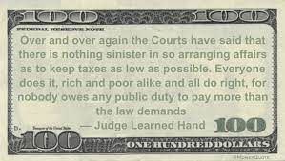
Judge Learned Hand

Slide 5
For retirees, tax planning spans income tax and estate planning. See a professional well schooled in both.
For effect Tax Planning, you should have four types of accounts:
1. Taxable cash accounts in interest paying accounts
2. Non-retirement account investments
3. Retirement account investments that Require RMDs and
Can distribute more than RMD, reduces next years RMDs
4. Accounts that do not Require RMDs – Roths, except inherited Roths, Real-estate.

Slide 6
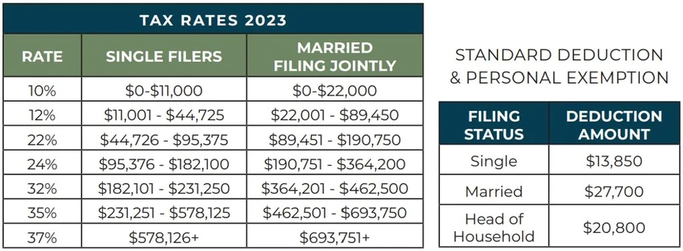

Slide 7
HAVE YOUR PROFESSIONAL RUN TAX A “SLAYER” SOFTWARE TO PLAN 2023 & 2024
In 2024 MN is likely to MN Standard Deductions the same as Federal, but many other
previsions are treated in MN’s own way!
++++++++++++++++++++++++++++++++++++++++++++++++++++++++++++++++++++++++
Federal 2023 Standard Deduction Increases to:
Not 65; Not Blind - - +1500 per 65+ or Blind+
MFJ & QSS 27,700 or 29,200 or 30,700 or 33,700 QSS – Serving spouse died 2021/22
1,850 65+ or Blind+ both
HOH 20, 800 or 22650 or 24500
S 13,850 or 22650 or 24500 MFS Complex. Without spousal agreement 0.

Slide 8
Federal Add Ups to Itemize:
Up to 10,000 state income or sales taxes + property taxes; www.IRS.gov. + Mortgage Interest. Not service charges, transfer tax, association fees or most assessments. If bought or sold during year, see Pub. 523
Large medical & dental including skilled care nursing,
Not made through HSA or FSA. Includes payments by others. Check payments made for another.
Large Charitable over 7.5% of AGI. No Fed w/Standard.
MN allows Itemize even if take Standard on Federal, and can deduct unreimbursed employee business expenses.

Slide 9
You will pay tax on your Social Security benefits based on Internal Revenue Service (IRS) rules if you:
File a federal tax return as an "individual" and your combined income* AGI is
Between $25,000 and $34,000, you may have to pay income tax on up to 50% of your benefits.
More than $34,000, up to 85% of your benefits may be taxable.
File a joint return, and you and your spouse have a combined income* that is
Between $32,000 and $44,000, you may have to pay income tax on up to 50% of your benefits.
More than $44,000, up to 85% of your benefits may be taxable.
Are married and file a separate tax return, you probably will pay taxes on your benefits.
* Your adjusted gross income (AIG)
+ Nontaxable interest
+ ½ of your Social Security benefits
= Your "combined income"

Slide 10
Some tips that may trigger you to conduct a full tax planning session to ensure your tax bill next year is not higher than it needs to be. (From LifeStyle Tax & Accounting Services: WWW.lifestyletaxes.com; 612-257-2748, published: 11/24/2023)
1. You owed tax last year. If you have not adjusted your withholdings, you could be in for a big tax bill. Time to take a look and plan accordingly.
2. Your household income changes dramatically. Whether higher OR lower, a change in income will impact your taxes, especially if it impacts availability of deductions or credits.
3. You are getting married or divorced. Married filing joint brings benefits and tax surprises. So does the impact of being single once again.
4. You have kids attending college next year. There are a number of tax programs that can help.
5. You have a small business. There are depreciation benefits plus the qualified business income deduction to consider. Plus you will need to understand the flow through impact your business profits will have on your personal tax return.
6. You plan on selling investments. Capital Gains tax rates can now range from 0% to 37% (depending on long or short term gains and your income level).
7. There are changes in your employer provided benefits. These changes could impact your taxable income this year.
8. You buy, sell or go through home foreclosure. There are tax benefits AND tax surprises when you buy or sell a home. A planning approach can make all the difference.
9. You have major medical expenses. The threshold for itemizing medical deductions is 7.5%. This means to itemize these expenses, they must exceed 7.5% of your income. But with proper planning, there are other ways to pay these expenses with pre-tax money!
10. You recently lost or changed jobs. Federal unemployment benefits are taxable and need to be accounted for in your tax plan.
11. Your estate has not been reviewed in the past 12 months. New gift tax and estate tax laws make 2013 a key year for an estate tax review

Slide 11
6 year-end money deadlines not to miss. FIDELITY VIEWPOINTS®. WEEKLY EDITION: November 16, 2023 ( Includes truncated excerpts from Fidelity)
Consider Key Takeaways: Talk to a trusted tax advisor to see if any of these moves might benefit you.
Year-end is your last chance to get financial tasks completed so they can be included in tax year 2023.
Some planning tasks have a hard stop at the end of December to be included with 2023 taxes. They include spending Flexible Spending Account (FSA) funds, completing a Roth conversion, contributing to a 401(k), contributing to charity, taking an RMD if you are of a certain age, and harvesting tax losses. Some tax moves can be made up to April 15 2024, like contributions to Roths and to Small Business Retirement Accounts.
1. Must make RMDs if you are 73 or older. If you were 72 after Dec. 31, 2022.
2. Charitable Distributions can lower your tax bill this year. When taking the Standard Deduction. Qualified Charitable distributions can satisfy RMDs. You can give more than your RMD; it will deduce RMD for 2024.
3. Are you considering a Roth conversion? Roth conversions can be done in kind, in other words you can often transfer assets from a traditional IRA to a Roth IRA without selling. You do still owe tax on the conversion. As an Employee, make sure you've contributed to tax-advantaged accounts, at least up to any Match. Contribute to Roth Accounts when you tax bracket is lower than when retired.
If you knew your stock would increase, do the conversion early in the year, and vice-versa. I want to hire you if you know!
4. If you itemize your taxes, you can deduct charitable donations to qualified organizations from your taxes. In general, you can deduct up to 60% of your adjusted gross income (AGI) for cash donations, per IRS rules. For donations of appreciated securities, you may be able to deduct 30% of your AGI. Itemizers may benefit from with a strategy called bunching. The catch is that this strategy requires having the financial capacity to pack more than a year's worth of your donations into a single year.
5. Money left in your FSA may be lost if not used by year-end or date delayed by an employer.
6. Investment losses. Losses can offset up to $3,000 of ordinary income annually and can be carried over to a higher tax bracket year if you only know.
7. Roth retirement accounts available through your employer’s 401(k) or 403(b) plans aren’t subject to individual account limits, and you can generally contribute more to them than to an individual Roth IRA. Getting a handle on expenses for individual IRAs is easier. Between fee-based brokerage accounts, low-cost or no-load mutual funds, and other possibilities, you have a wide variety from which to choose.

Slide 12
Required Minimum Distributions (RMDs)
https://www.irs.gov/retirement-plans/retirement-plan-and-ira-required-minimum-distributions-faqs
Required minimum distributions (RMDs) are the minimum amounts you must withdraw from your retirement accounts each year. You generally must start taking withdrawals from your traditional IRA, SEP IRA, SIMPLE IRA, and retirement plan accounts when you reach age 72 (73 if you reach age 72 after Dec. 31, 2022). Beginning in 2023, the SECURE 2.0 Act raised the age that you must begin taking RMDs to age 73. If you turn 73 this year, you must begin withdrawing from your retirement accounts by April 1, 2023.
You can withdraw more than the minimum required amount.
Your Non-Charitable withdrawals are included in taxable income except for any part that was already taxed (your basis) or that can be received tax-free (such as qualified distributions from designated Roth accounts or a QCD). Qualified charitable donations made directly from your IRA to a qualified charity, up to a maximum of $100,000, will also be excluded from taxable income, provided you are over the age of 70½ .

Slide 13
RMD questions Before Year-end
https://www.fidelity.com/retirement-ira/required-minimum-distribution-faq. (Questions? 800-343-0860 7:00a – 11:00p week days.
https://www.irs.gov/retirement-plans/retirement-plan-and-ira-required-minimum-distributions-faqs
Generally must start taking withdrawals from your traditional IRA, SEP IRA, SIMPLE IRA, & retirement plan accounts when you reach age 72 (73 if you reach age 72 in 2023.
SECURE 2.0 Act of 2022 once again delays the RMD age from
72 to 73 starting in 2023. When must RMD be made by Dec. 31, 2023 of by April 1, 2024?
And in 2033, the RMD age will increase to age 75.
Active employees are not required to do RMDs. It’s Complex.

Slide 14
Account Types For RMDs RMDs must be taken out of IRA accounts,
No RMDs for Roth IRAs, unless inherited
Traditional IRAs Rollover IRAs SIMPLE IRAs | SEP IRAs Most 401(k) & 403(b) 457 (b) & Profit Sharing plans Roth IRA beneficiaries Other defined contribution plans

Slide 15
2 rules that help simplify things
Rule 1: Aggregating RMDs: RMDs are calculated separately for each of your retirement accounts. Seems like a lot to manage, but here’s an important rule making it a bit easier: If you have more than one IRA, you can total up their RMDs and withdraw it from a single IRA. Same thing for 403(b) accounts—you can take all their RMDs from a single 403(b). But there’s one big exception to the rule: 401(k)s. If you have more than one 401(k), you need to withdraw the RMD from each individual 401(k).
Rule 2: The Working Non-owner: Are you still working, while not owning more than 5% of the company? Then you generally do not have to take RMDs from your workplace retirement plan until you retire.
Top RMD questions for 2023 at Fidelity site:
https://www.fidelity.com/retirement-ira/required-minimum-distribution-faq
Money Markets? Securian- ML GEN ACCT LIMITED. VALIC/AIG still paying 4.5%.
Take RMD from other lower interest accounts.

Slide 16
MANAGE RMDS (Required Minimum Distributions)
Take Control From Automatic RMD
Total Sum of RMD of All Tax Deferred Accounts. Can do from one account. Avoid high penalties, but Contact IRS, to unwind.
No RMDs for Roth IRAs, unless inherited.
Complex IRS rules limit spread to10 years.
Conversion To Roths & Contributions To Roths
Pay income taxes on conversions & contributions.

Slide 17
Required Minimum Distributions (RMD) Questions
Can an account owner just take a RMD from one account instead of separately from each account? Yes!
Can an account owner withdraw more than the RMD? Yes!
Can the penalty for not taking the full RMD be waived? Yes, the penalty may be waived if the account owner establishes that the shortfall in distributions was due to reasonable error and that reasonable steps are being taken to remedy the shortfall. In order to qualify for this relief, you must file Form 5329 and attach a letter of explanation. See the Instructions to Form 5329PDF

Slide 18
How are RMDs determined in a Defined Benefit Plan?
A defined benefit plan generally must make RMDs by distributing the participant's entire interest in periodic annuity payments as calculated by the plan's formula for:
the participant's life,
the joint lives of the participant and beneficiary, or
a "period certain" (see Treas. Reg. §1.401(a)(9)-6, A-3).

Slide 19
RMD & Estate Planning
The entire balance of a deceased participant's account must be distributed within ten years. Except for a surviving spouse, a child who has not reached the age of majority, a disabled or chronically ill person, or a person not more than ten years younger than the IRA account owner.
For more information on IRAs, including required withdrawals and beneficiaries, see:
Retirement Topics – Beneficiary
Publication 590-B, Distributions from Individual Retirement Arrangements (IRAs)
Required Minimum Distributions (RMDs)
Individual Retirement Arrangements (IRAs)
Required Minimum Distribution Worksheets for IRAs
Chart of required minimum distributions for IRA beneficiaries
Publication 560, Retirement Plans for Small Business (SEP, SIMPLE and Qualified Plans)
RMD Comparison Chart (IRAs vs. Defined Contribution Plans)

Slide 20
Qualifies for the Earned Income Tax Credit (EITC)
https://www.irs.gov/credits-deductions/individuals/earned-income-tax-credit/who-qualifies-for-the-earned-income-tax-credit-eitc
Low- to moderate-income workers with qualifying children may be eligible to claim the Earned Income Tax Credit (EITC) if certain qualifying rules apply to them.
You may qualify for the EITC even if you can't claim children on your tax return. Find out how to claim the EITC without a qualifying child.
Basic Qualifying Rules
To qualify for the EITC, you must:
Have worked and earned income under $59,187
Have investment income below $10,300 in the tax year 2022
Have a valid Social Security number by the due date of your 2022 return (including extensions)
Be a U.S. citizen or a resident alien all year
Not file Form 2555, Foreign Earned Income
Meet certain rules if you are separated from your spouse and not filing a joint tax return
Special Qualifying Rules
The EITC has special qualifying rules for:
Military members
Clergy members
Taxpayers and their relatives with disabilities
If you're unsure if you qualify for the EITC, use our Qualification Assistant.

Slide 21
Qualify for EITC & Energy Efficient Improvement Credit?
From Todd’s Koch 11/13/23
If you qualify for the EITC, you may also qualify for other tax credits.
Child Tax Credit and the Credit for Other Dependents
Child and Dependent Care Credit
Education Credits
https://www.irs.gov/credits-deductions/energy-efficient-home-improvement-credit
Beginning Jan. 1, 2023, the credit equals 30% of certain qualified expenses, including: Qualified energy efficiency improvements installed during the year
Residential energy property expenses
Home energy audits

Slide 22
Issues of Surviving Spouses Considering Marriage
Issues for Surviving and Divorced Spouses to Consider:
A married spouse in MN is responsible for the long term care payments and the reimbursement of Medicaid payments benefiting a spouse.
Prenuptial agreements can separate financials and satisfy family concerns of a blended family. Prenuptial agreements cannot avoid liability for a spouse’s long term care and Medicaid obligations.
Continue their separate accounts, but have the same CPA/CFP for tax filing to coordinate plans and cash flow.
Have one partner/spouse satisfy their RMD with QCD; tell the Charity it’s a donation from both. The spouse/partner can give cash to the other equal to ½ of the QCD.
When a surviving or divorced spouse marries, they may lose the 1/2 of the divorced spouse’s social security, or the higher Social Security when the divorced spouse dies.
When one spouse passes away, the surviving spouse could pay nearly double the amount of income taxes. When a person’s tax filing status goes from married filing jointly to single. Are you planning for this? https://www.kiplinger.com/taxes/optimize-your-taxes-with-these-common-strategies

Slide 23
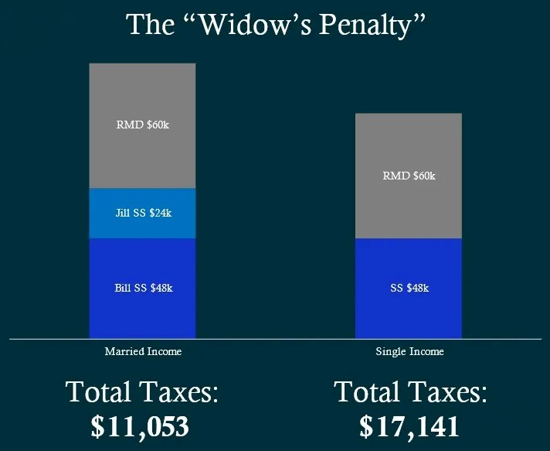
The Surviving Spouse “Penalty”
Both were older than 73, which means they were forced to take required minimum distributions (RMDs) However, there were two major changes that occurred. The first was that Jill’s Social Security fell off. When one spouse passes away, their Social Security income goes away, and the higher of the two remains. It is great that Jill can take the higher of the two but unfortunate that she will have a loss of income from what she was used to. The second change was that Jill’s tax status went from married filing jointly to single.

Slide 24
Two things can increase the Surviving Spouses' penalty
As you can see from these charts :
The standard deduction gets cut in half. This means the surviving spouse will be left with less tax-free income.
The tax brackets are smaller. For example, if you have $85,000 of taxable income and you are married filing jointly, then you are in the 12% tax bracket, but if you are single with $85,000 of taxable income, then you will be in the 22% tax bracket. See how this can be an issue? This is how that near doubling of taxes can occur.
Not only will the surviving spouse have less income, but they will also have to pay more taxes, which leaves them with less money during the time when they need it the most. How do we plan for this?
Taxes are not likely to be lower in the future, so you could utilize strategies like a Roth conversion to maximize these types of opportunities. Another consideration is optimizing when you take Social Security to ensure your spouse will be left with the highest benefit when you pass away. Lastly, if you are going to be drawing larger RMDs in the future, now is the time to start reducing that potential liability, to leave your spouse with less taxable income in the future when it matters the most. Unfortunately the surviving spouse's penalty can be server.

Slide 25
DISTRIBUTIONS TO FAMILY- - GIFTS TO LOWER INCOME TAX
Fund Roth IRAs of a Child When the Child Earns Income.
Fund Gifts to Minors, or Coverdale Savings, or “529 Plans”
When viewing investment ranking of 529 plans, beware of Investment Rankings based only on annual investment returns. Check 5 & 10 year rates of return.
Home // College Savings 101 // Coverdell ESA // Coverdell ESA providers
Gifts: $17,000 Single & $34,000 Joint per donee are not gift limits. But may have to file a 709 Gift Tax return. Everything over limits will reduce your lifetime exclusion for Estate Taxes. Most do not worry about the lifetime exclusion amount.

Slide 26
IRS-- Payments for Education Generally Not Deductible
Credits May be Available. https://www.irs.gov/newsroom/tax-benefits-for-education-information-center. You can’t generally use private school tuition to directly reduce your taxes. There’s some tax relief in Coverdell Education Savings Accounts, allows invest in education savings without paying tax on the earnings. If your modified adjusted gross income is above limits, there’s a gradual reduction in your contribution limits. Tax credits: There are two education credits available: the American Opportunity Tax Credit and the Lifetime Learning Credit. Tax deductions and savings plans can help taxpayers with expenses for higher education.

Slide 27
Key Roth IRA Features
Roth IRAs contributions for spouses with no current income.
Contributions to Roth IRAs for minors Earned Income Self-employed, royalties, side-gigs, with a SEP IRA.
“Complex”, Subject to RMD; but not QCD.

Slide 28
MANAGING QUALIFIED CHARITABLE DISTRIBUTIONS (QCD)
Carefully distribute, document, and inform your tax preparer or you may be taxed on the QCD distribution.
Spouses/Partners coordinate QCDs
MN Rev. Takes Tax – File exempt Form.

Slide 29
Consider QCD To:
Grandkid’s Charities
Charities
Spouses/Partners’ Charities

Slide 30
Making Qualified Charitable Distributions (QCD)
Carefully document the transfer.
Tell tax preparer: Form 1099-R, (07), “Normal Dist.” Signal Fed tax withheld 0, But MN?
Distributions QCDs honor: Veterans, First Responders; Religion, UMN Foundation; be Specific.

Slide 31
FUNDING ROTH IRAs
It’s all in Ed Slott and Company, LLC, Book An action plan to help you make sure your retirement savings aren't depleted by taxes (Not so easy when you are retired.)
Have only a person beneficiaries on a Roth, not a Charity. (More in Estate Planning Workshop)

Slide 32
Why consider a Roth conversion now?
What to invest in?
Taxes could rise, making a Roth conversion a timely strategy to consider.
https://www.fidelity.com/learning-center/personal-finance/retirement/answers-to-roth-conversion-questions

Slide 33
USING A DONOR ADVISED ENDOWMENT FUND
Good yearend tax planning for future charitable distributions.
Warning: Distributions do not qualify RMDs, and not deductible; only contributions are deductible when you Itemize. Fidelity web site:
https://www.fidelitycharitable.org/insights.html?_ga=2.237356480.1568814149.1631481977-1485351185.1561653700

Slide 34
Make your Donation on line or Call Fidelity Retirement: 800-343-0860. Log in. On “All Accounts” page. Go to search in upper right corner; put in QCD.
Click On: Qualified charitable distributions (QCD) - IRA one-time withdrawal online form.
Make a donation to an eligible charity.
From which account do you want to initiate the distribution?
Select your IRA or IRA Rollover account (not a Roth IRA)
Continue: Name of Charity. Where sent, charity address? Or yours?
Additional information on check Memo. Don’t put thanks for the Teddy Bear or thanks for membership, state: “No Goods or Services were exchanged”. Copy the confirmation.

Slide 35
Check with UMN Foundation for more gifting methods:
https://give.umn.edu/waystogive ​Contact Robyn White at rwhite@umn.edu for assistance giving through give.umn.edu or the crowdfunding platform. Phone: 612-624-3333 or 800-775-2187 Email: giving@umn.edu
Check with Fidelity for more gifting methods:
https://www.fidelity.com/viewpoints/retirement/IRA-things-to-know
Retirement Service Center; 800-343-0860; tell auto phone, 403(b) to get through faster.
Evelyn A. Rhines, CRPC , Workplace Financial Consultant, works locally in the Minneapolis area.
Click here to schedule an appointment with her.
C
CHECK ANNUITY PURCHASE DECISIONS
Two general information links for annuities:
1. Minnesota Commerce Department annuity information guide:
.
2. Funding your retirement with an annuity . . .does it make sense?:
3. Check UMN 403 (b) Pre 7-1-1989 for male & female rates, not unified rates used after this date.

Slide 36
Please send to me questions and suggestions on any topic in the outline. awhitman@umn.edu; or 612-747-6015.
We feel the pain of the terrorist attacks, pandemic “Unwinding”, wild fires, hurricanes and draught. Hopefully we unite as “A “Force for Good” CSOM’s Mantra.

