Slide 1
Preparing for the
Future of Caregiving in Minnesota
A Review of Wilder Research Studies on Caregiving
and
A Description of Wilder’s Caregiver Services
A presentation to the
University of Minnesota Retirees Association
November 28, 2017
By Greg Owen

Slide 2

Minnesota is officially in a period of rapid demographic change.
Notes:
231 countries around the world (about 99% of the world) are expecting to see an increase in their aging population.
By 2050, the world population of older adults is expected to double and reach 2 billion.
Growth in the older population does not help the economy of a country. Countries lack the younger workforce it needs to keep production rising. Older people need more care and other forms of transportation.

Slide 3
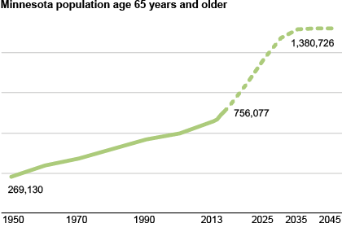
Between 2010 and 2030 Minnesota’s older adult population will more than double!
2045
2013
2010
Notes:
NOTE: the projections may be off (low) – if so, correct this graph (and the info in the insights column)

Slide 4
What do we know about caregiving today
  Caregivers are managing complex conditions
  Being a caregiver can be isolating and stressful
  Stressors often greater for those with little support
  Caregivers often lack knowledge of services
  90%+ of care recipients want to remain at home
  Increased longevity results in greater number of care recipients with some form of dementia
  Recent MBA study shows one-half of MN caregivers care for someone with dementia
Notes:
Increase in population of older adults and older adults are living longer
Fewer informal/family caregivers available
Many older adults choose to age in the community
Experience of caregiving is diverse--families and situations vary based on race, ethnicity, SES, and disease trajectory
Caregiving is stressful/keeping caregivers healthy is a priority
Approximately 34.2 million Americans have provided unpaid care to an adult age 50 or older in the prior 12 months (Results of a national study by AARP Public Policy Institute and National Caregiving Alliance, Caregiving in the U.S. 2015)
Economic value of informal caregiving for people with ADRD was $217.7 billion in 2014. =46% of the net value of Walmart sales in 2013 and 8x the total revenue of McDonalds in 2013

Slide 5
A few caregiving statistics
585,000 caregivers provided unpaid care to an adult in Minnesota (AARP, 2015)
Estimated annual value of caregiving in MN is $7.86 billion
Family caregivers often struggle with health, employment, or both
Funding for federally funded services for caregivers has remained flat while the number of caregivers served has increased every year

Slide 6
What factors will shape the future of caregiving and caregiver services in MN?
Dramatic increase in the number and diversity of older adults with long-term care needs including dementia
Projected decline in available caregivers
Uncertain status of Affordable Care Act (ACA) legislation that emphasizes a Community First Choice Option and encourages a rebalance of Long-Term Care (LTC) with greater emphasis on supporting care at home

Slide 7
What factors will shape the future of caregiving and caregiver services in MN?
2008 Health Care Home legislation that incents hospitals and clinics to create strong partnerships with families and community resources
Widely used central referral mechanism (SLL) that makes caregiver supports more accessible
State of Minnesota public awareness campaign to reach more caregivers

Slide 8
How will more recent state actions impact the future of caregiving services?
2012 law requires those wishing to enter assisted living programs to contact Senior LinkAge Line® (SLL) and receive offer of Long-Term Care Consultation (LTCC) services
2013 law further modified the work of the SLL and role in care transitions requiring hospitals and health care homes to refer older adults at risk of nursing home placement to the SLL
Minnesota’s Return to Community Initiative

Slide 9
Recent research shows many challenges for caregivers
The majority of caregivers receive little informal support, have poor knowledge of available services
Caregivers have difficulty planning ahead for the relative’s future care needs
Caregivers themselves report a lack of preparedness to provide care
Those caring for family members with dementia often feel trapped because of the constant and substantial needs of their care recipient

Slide 10


Understanding Caregivers’ Networks of Support
The Caregiving in Context Study

Slide 11
Key Study Questions
Who are the caregivers and how did they assume their role?
Where do caregivers look for help or guidance?
How are caregivers supported and what do their networks of informal support look like?
What do caregivers say would help them the most?

Slide 12
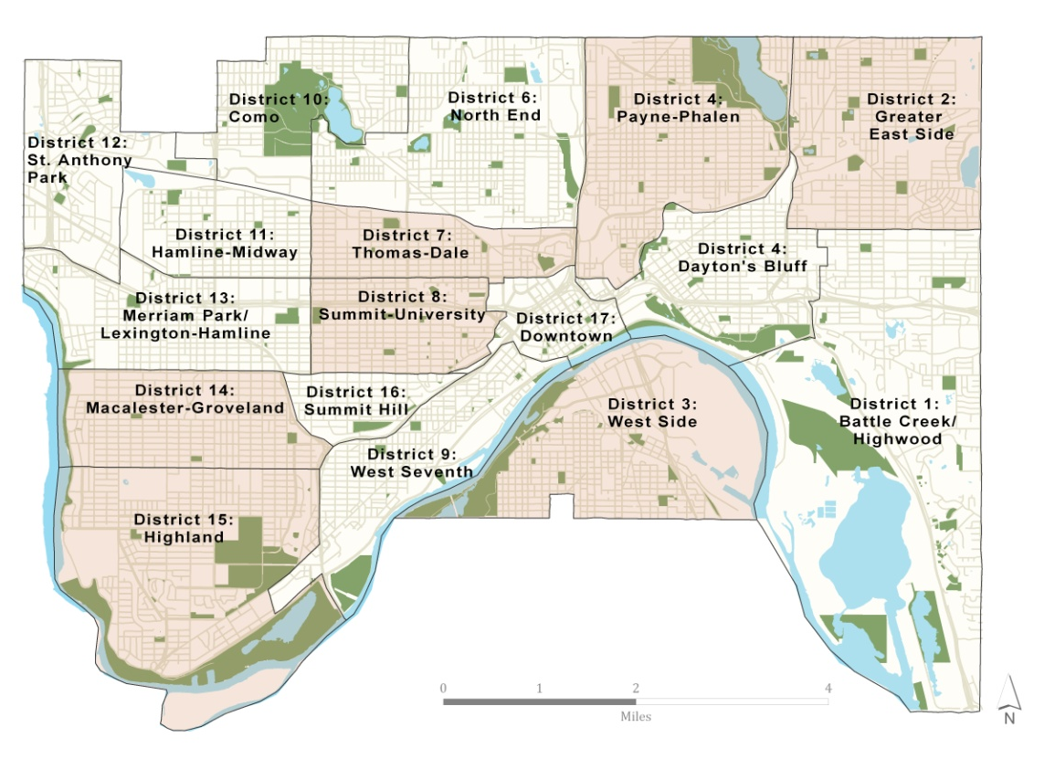
Who we talked to...
In-depth interviews with 212 caregivers in St. Paul
141 Primary caregivers
  (mainly responsible for care of older adult)
71 Secondary caregivers
  (assist an older adult)

Slide 13
Who we talked to...
Average age
  Caregivers: 57
  Older adults: 80
Caregivers are diverse:
  Men (31%) and women (69%)
  25% people of color
  29% at or below 200% poverty
  54% employed full-time
  Spouses, adult children, friends, and neighbors

Slide 14
Who they are...

Slide 15
Pathways to caregiving
“My sister and I provide the support to my mother jointly.
We met as a family and talked about how we were going to deal with the challenges.”
One in five (21%) said they planned to be
a caregiver.
  “My father remarried after my mom died, and his second wife died in March 2010. At that point, my father decided that
  he wanted me to become his primary caregiver.”
62% said their expectation
of becoming a caregiver simply fell to them.

Slide 16
Caregiving: A snapshot
86% spent at least 1 year in role of caregiver; 30% spent 10 years or more
Average time spent providing care:
  Primary caregivers: 37 hours per week
  Secondary caregivers: 9 hours per week
One in four (40%) share their home with the older adult they care for
(mostly primary caregivers who are relatives of the older adult)

Slide 17
Caregiving: A snapshot
Caregivers assist with a wide variety of tasks.
- 69% of caregivers help with 5 or more of these daily tasks
19% of caregivers help with all 10 daily tasks listed here

Slide 18
Focus on support
What is the most important resource that supports you as a caregiver? (N=141)
Support from family,
friends, and/or neighbors
Notes:
Mention here that the rest of the data presented is about primary caregivers ONLY

Slide 19
Measuring informal support networks
8 items in our scale:
Help with caregiving tasks
# of family members assisting the caregiver
# of others outside family assisting caregiver
# of tasks the caregiver received help with in the past month
Support in caregiver’s absence (1 month or longer)

Slide 20
Measuring informal support networks
Reaching out for support
5. # of people the caregiver reached out to for help, who then began to help
6. # of community activities used for support
7. # of different information sources used

Slide 21
Measuring informal
support networks
Emotional support
8. Weekly contact including:
  personal visits;
  phone; or
  email contact
with a close friend or family member about their caregiving role

Slide 22
Informal support networks
Lower score (0 to 4)
Caregiver has less informal support overall.
Moderate score (5 to 7)
Caregiver has a range of informal supports in place
High score (8 to 14)
Caregiver is
well-supported
by family members or friends.

Slide 23
Caregivers with lower scores
Who they are
More men than women; lower income households; not working; living with the older adults
Spouses, sons, other relatives
Felt role of caregiver was expected of them
Intense level of commitment (hrs per week, tasks) with fewer using home-based services
51% using home-based services
Caregiving role

Slide 24
Caregivers with higher scores:
Who they are
Women; somewhat younger, employed; not living with older adults; caring for others
Daughters, some wives, and few sons
Fewer hours per week and tasks
More years in caregiving role
60% using formal services
Caregiving role

Slide 25
Informal support matters
Caregivers with lower network score | Caregivers with higher network score
43% feel other family members could be helping but are not | 21% feel other family members could be helping but are not
More likely to describe health as “fair” or “poor” | More likely to describe health as “excellent” or “very good”
19% described caregiving as “very stressful” | 4% described caregiving as “very stressful”

Slide 26
What caregivers say would help them
Information about services and financial asst.
Advice and support related to caregiving tasks
Help identifying quality services
Finding other caregivers to talk with and places to connect for support and education
Help with basic needs like transportation, financial support, and care
Respite care

Slide 27
Other recent Wilder studies of caregiving
MAAA focus group study
BC/BS Worksite support of caregivers
Entira/Wilder caregiver study
Review of Social Security Title III-E service

Slide 28

Wilder’s Community Center for Aging

Slide 29
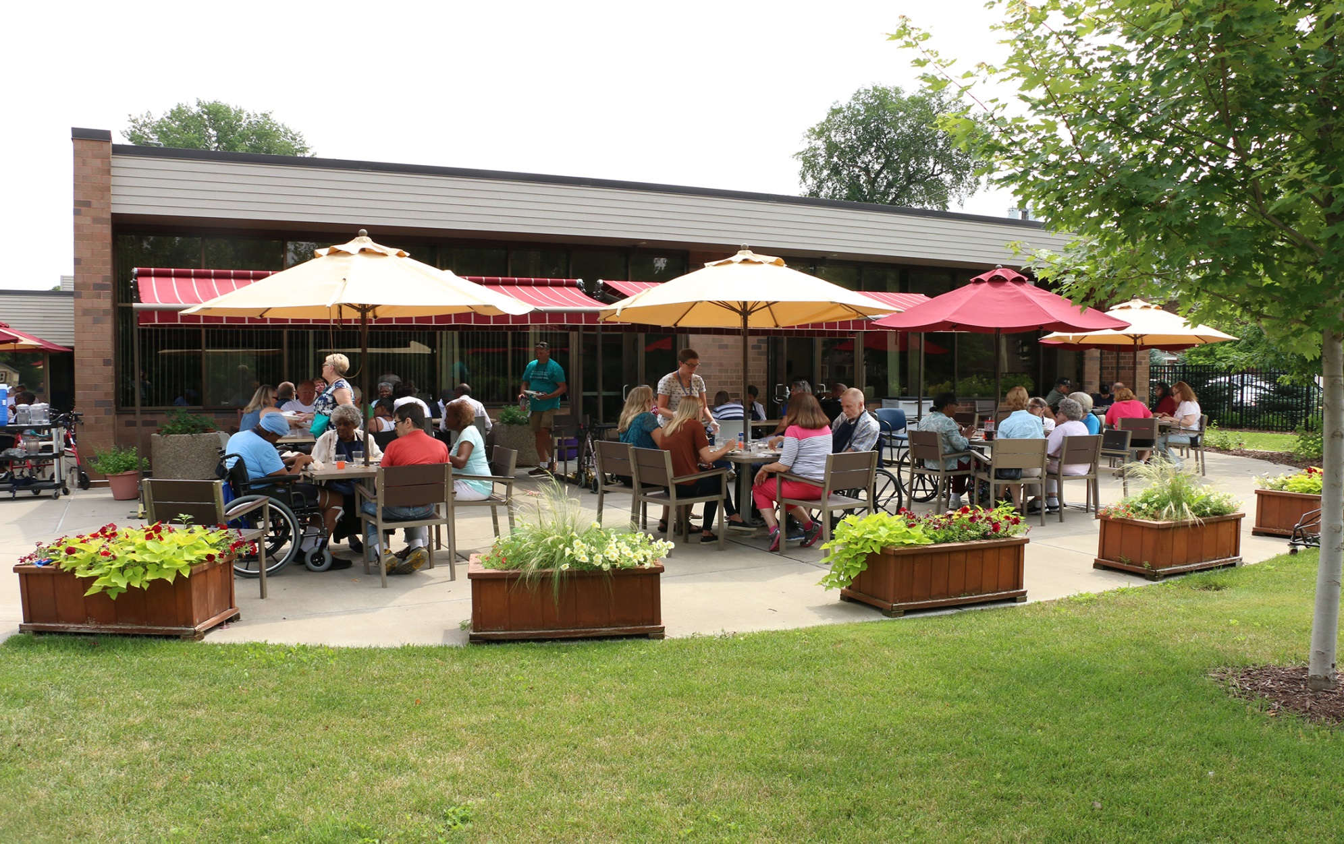
Wilder’s Caregiver Services

Slide 30
Caregiver Coaching and Consultation
Phone, email, or in-person services & support
A wide range of supports including:
  consultation
  coaching
  comprehensive assessments
  in-home visits
  service information

Slide 31
Family Meeting Facilitation
Support in resolving family issues
Facilitation of family meetings to:
  Promote effective group communication
  Set goals and make decisions
  Plan for the future
  Assist long-distance caregivers

Slide 32
Other Caregiver services available from Wilder
P.S. I Understand – a peer-to-peer support program involving experienced caregivers
Caregiver support groups – provide a community of support and understanding
Caregiver education – educational opportunities to learn more about an illness, strategies for communication, ways to manage emotions
Respite care – help in arranging time away from your caregiving responsibilities

Slide 33
Caregivers who receive caregiver services report …
Improvements in their caregiving skills
More confidence handling their caregiving responsibilities
Greater ability to meet the needs of the person they care for
A reduction of strain they feel in their caregiving role
Being more hopeful or optimistic about their ability to continue their caregiving role in the future

Slide 34
Caregivers who receive caregiver services report they are …
Better able to take care of their own health
Better able to balance their caregiving with other responsibilities
More able to engage in social activities or favorite pastimes
  Source: Follow-up of Wilder Caregiver Services clients, 2014

Slide 35
To learn more about our research www.wilderresearch.org
To learn more about Caregiver Services visit our center at 650 Marshall in St. Paul contact (651) 280-CARE (2273) or email us at caregiving@wilder.org

