Slide 1
OUR GOPHERS

Slide 2
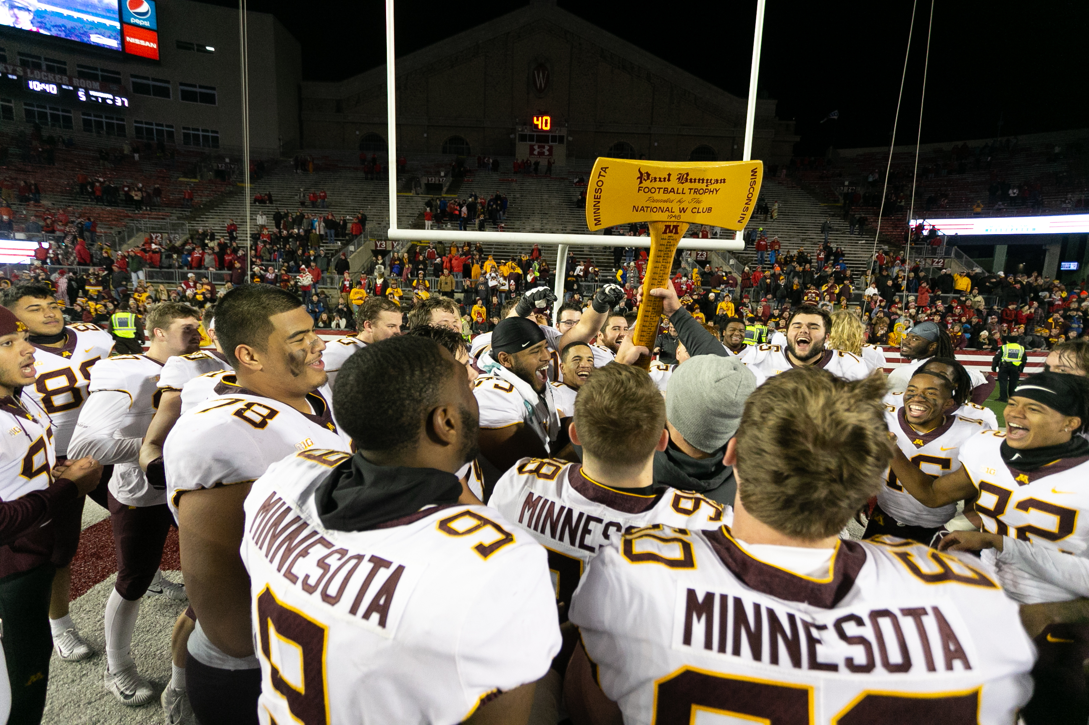
Key Facts
25 programs
700+ student-athletes
275+ full-time employees
FY19 budget of $121M
Notes:
25 programs are tied for the fourth most in the Big Ten, but operating budget is about eighth in the conference.
We talk about how we manage that budget and what we have to do to maximize that budget later in presentation.

Slide 3
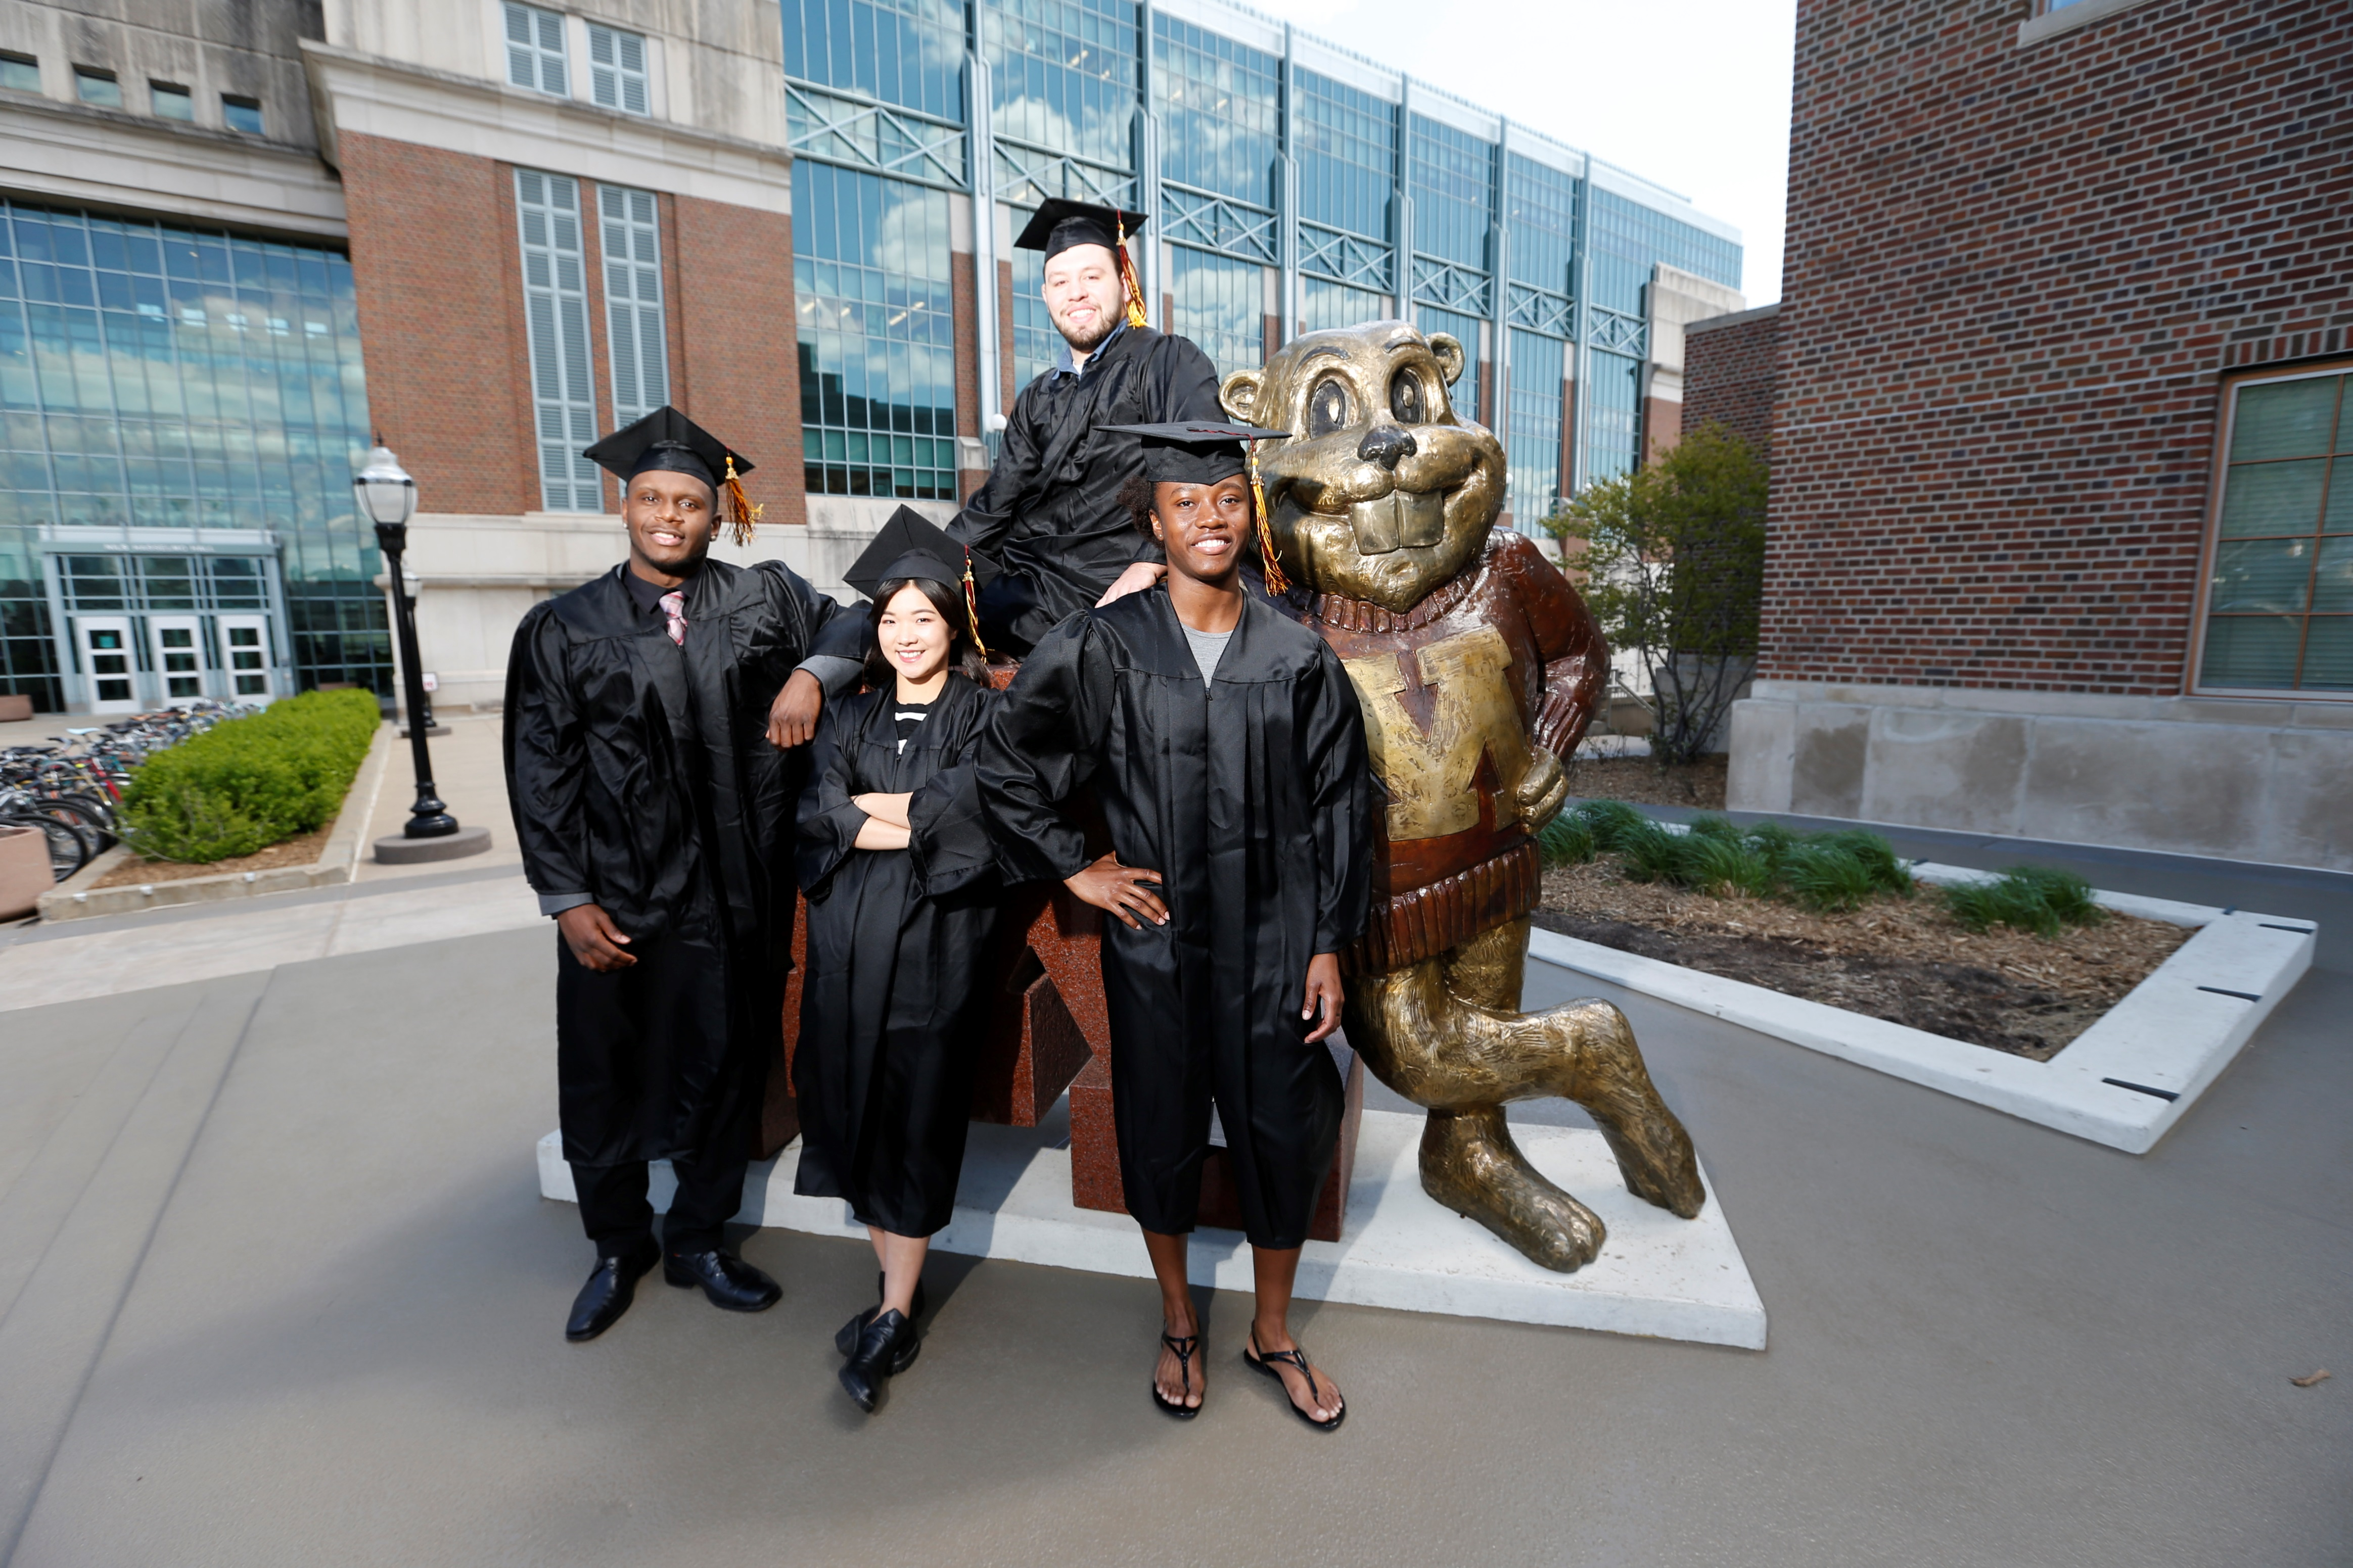
Our Students
10 straight semesters of 3.2+ GPA
2 GPA records set for highest in program history in fall 2018
93% Grad Success Rate (department record)
Notes:
Cum GPA for student-athletes through Fall 2018– 3.25
3.28 Fall 2018 term GPA, new department-record
Type of schools in same space with regard to academic performance/APR awards: Stanford, Notre Dame, Duke, Michigan…
93% GSR leads all public schools in the Big Ten
351 Academic All-Big Ten honorees last year (new department record)
102 Academic All-Big Ten honorees this fall (39 football, 28 women’s cross country, 15 soccer, 14 men’s cross country, 6 volleyball)
10 Academic All-Americans (second most in school history)
Academic All-Big Ten = at least second year at institution; play for team; 3.0+ GPA
Also had 108 Big Ten Distinguished Scholars last year (letterwinner with 3.7+ GPA) and 14 student-athletes with a perfect 4.0 GPA last year (school record)

Slide 4
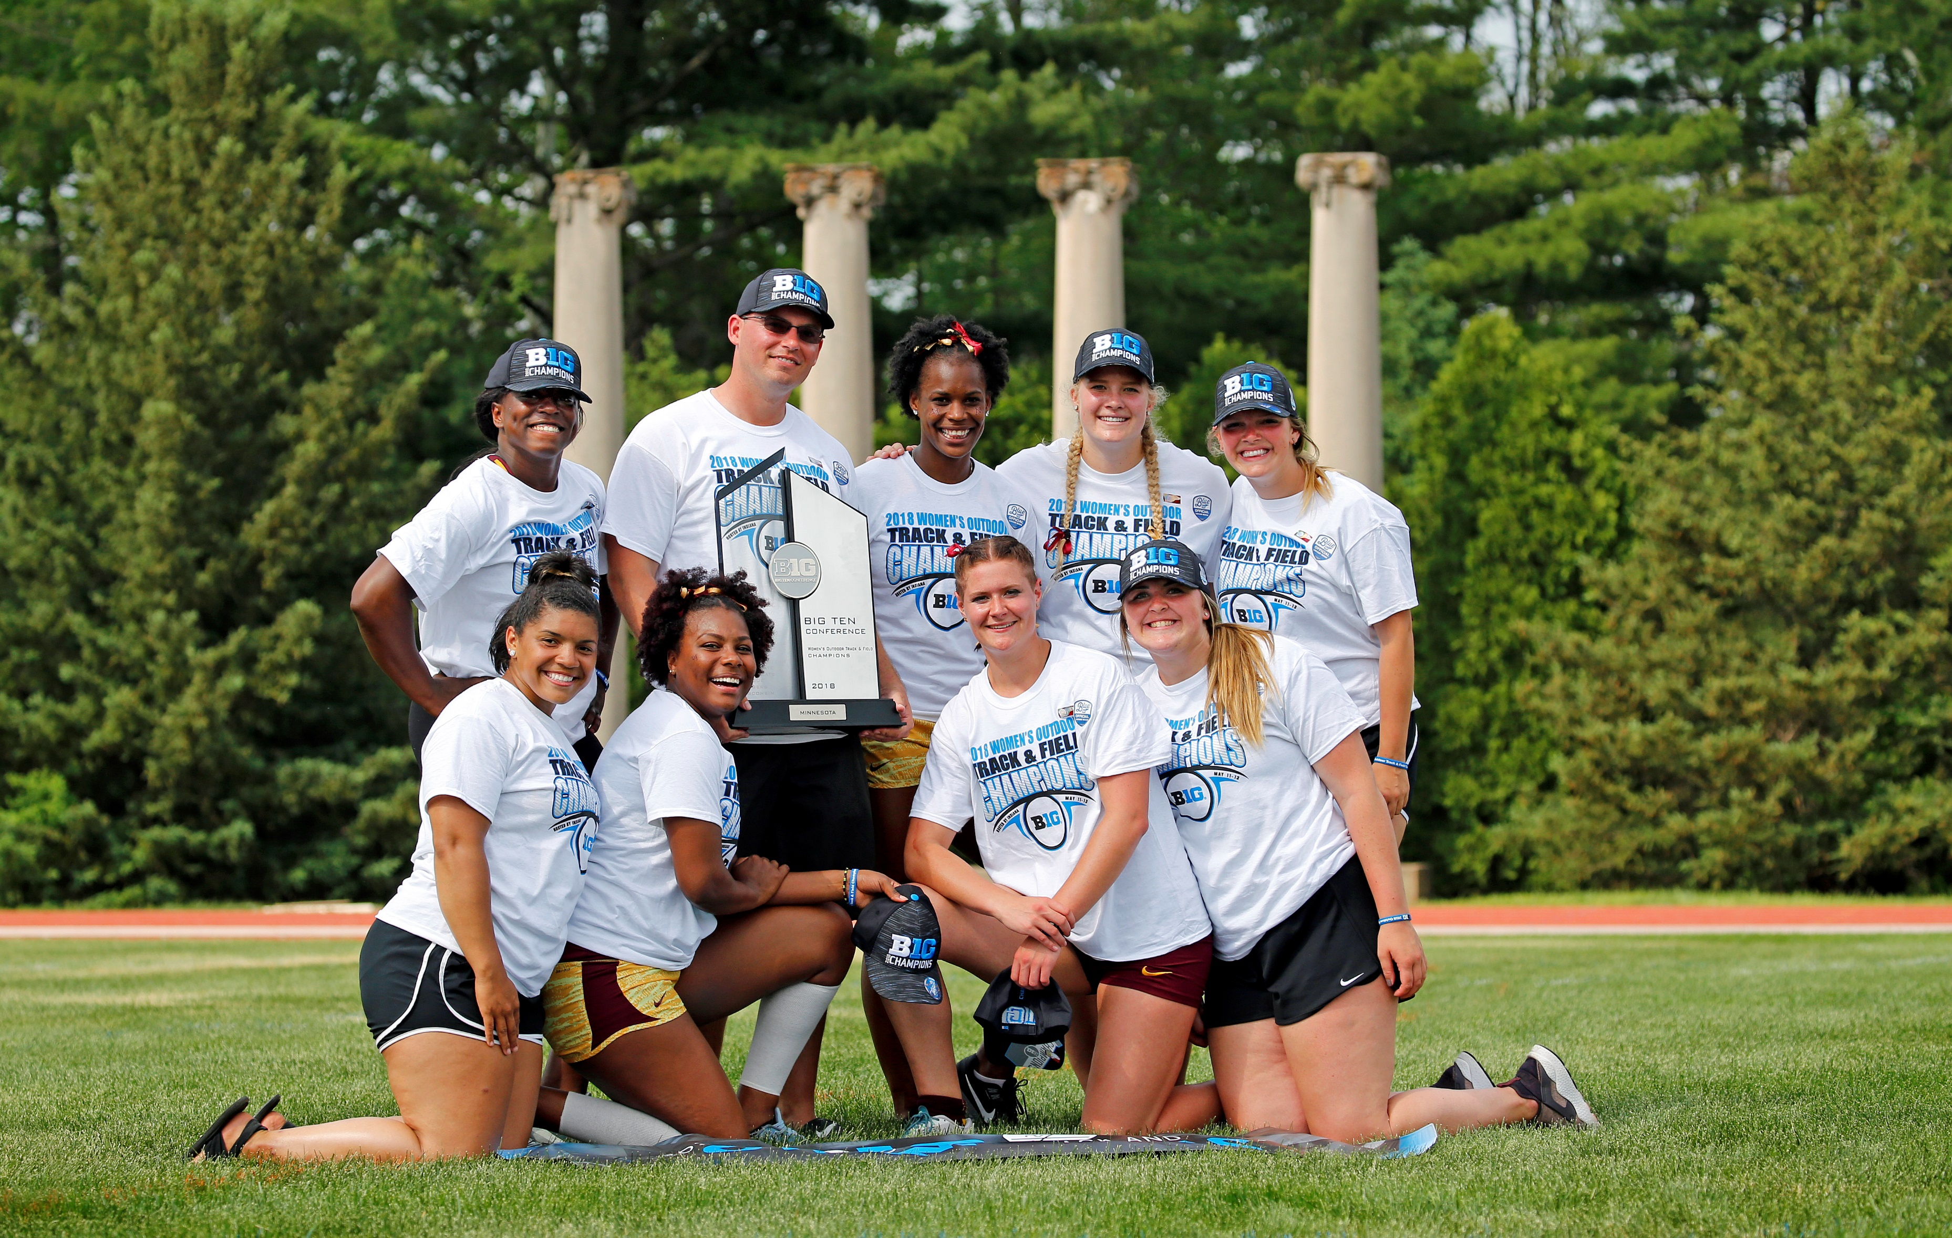
Our Athletes
19th in the Learfield Directors’ Cup
19 conference team titles since start of 2015-16 season
57 different All-Americans in 2017-18
Notes:
Pat Forde quote -
“Minnesota —perhaps the most overachieving athletic department in the country. The Gophers ranked 19th nationally in 2017-18 and 23rd over the five-year span.”
We also have 13 different programs (more than half) that have won conference team titles in the past 5 years
This year’s highlights:
Volleyball wins Big Ten, reaches second weekend of NCAA tournament (at least Sweet Sixteen) for the fourth straight year
Football wins Paul Bunyan’s Axe for first time in 15 years, wins Quick Lane Bowl in Detroit and finishes with winning record
Men’s Basketball earns four Power Five non-conference victories, currently projected as an NCAA tournament team
Big Ten titles for both women’s indoor and outdoor track and field, the first time the program has ever swept those two in the same year
Big Ten tournament title for softball (have now won three straight, four of the past five, and have the second most titles all time, trailing only Michigan)
WCHA tournament title for women’s hockey
Baseball swept Big Ten titles, hosted first NCAA regional in 18 years, deepest run in 41 years getting to Super Regionals
Men’s gymnastics matches best finish in program history – national runners-up
Men’s tennis advancing to the final weekend of NCAA Championships (Sweet Sixteen) for the first time in 18 years
Both swim/dive programs top-15 at NCAAs (15th for men best since ‘11; 10th for women is fourth top-10 finish in the past six years)

Slide 5
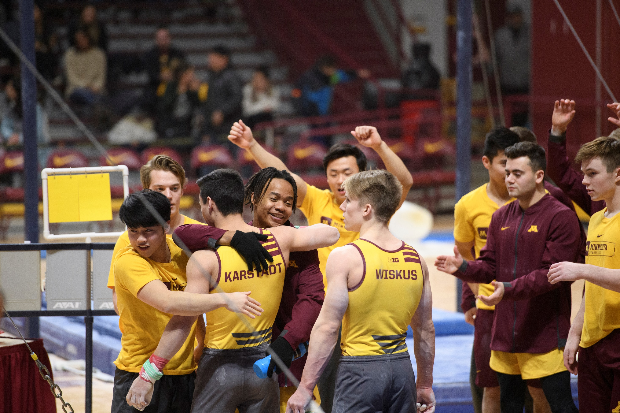
Continuing to Evolve
Notes:
During my first year especially –we dealt with some serious issues and managed through a time of transition and change.
I entered a department where leadership transition has been nearly constant:
Four athletics directors in a four-year span, and a lot of turnover in senior staff.
We also found ourselves challenged with budget numbers that were going to be incredibly difficult to meet, and a series of audits that began from before we arrived in Minnesota.
All of that meant it hasn’t been an easy path forward, but we’re into year three now and we’re in a very strong position.
Change is constant and we’ll see more of it I’m sure, but we have stabilized our department in many ways and are charging ahead from a stronger position than we have been in many years.

Slide 6
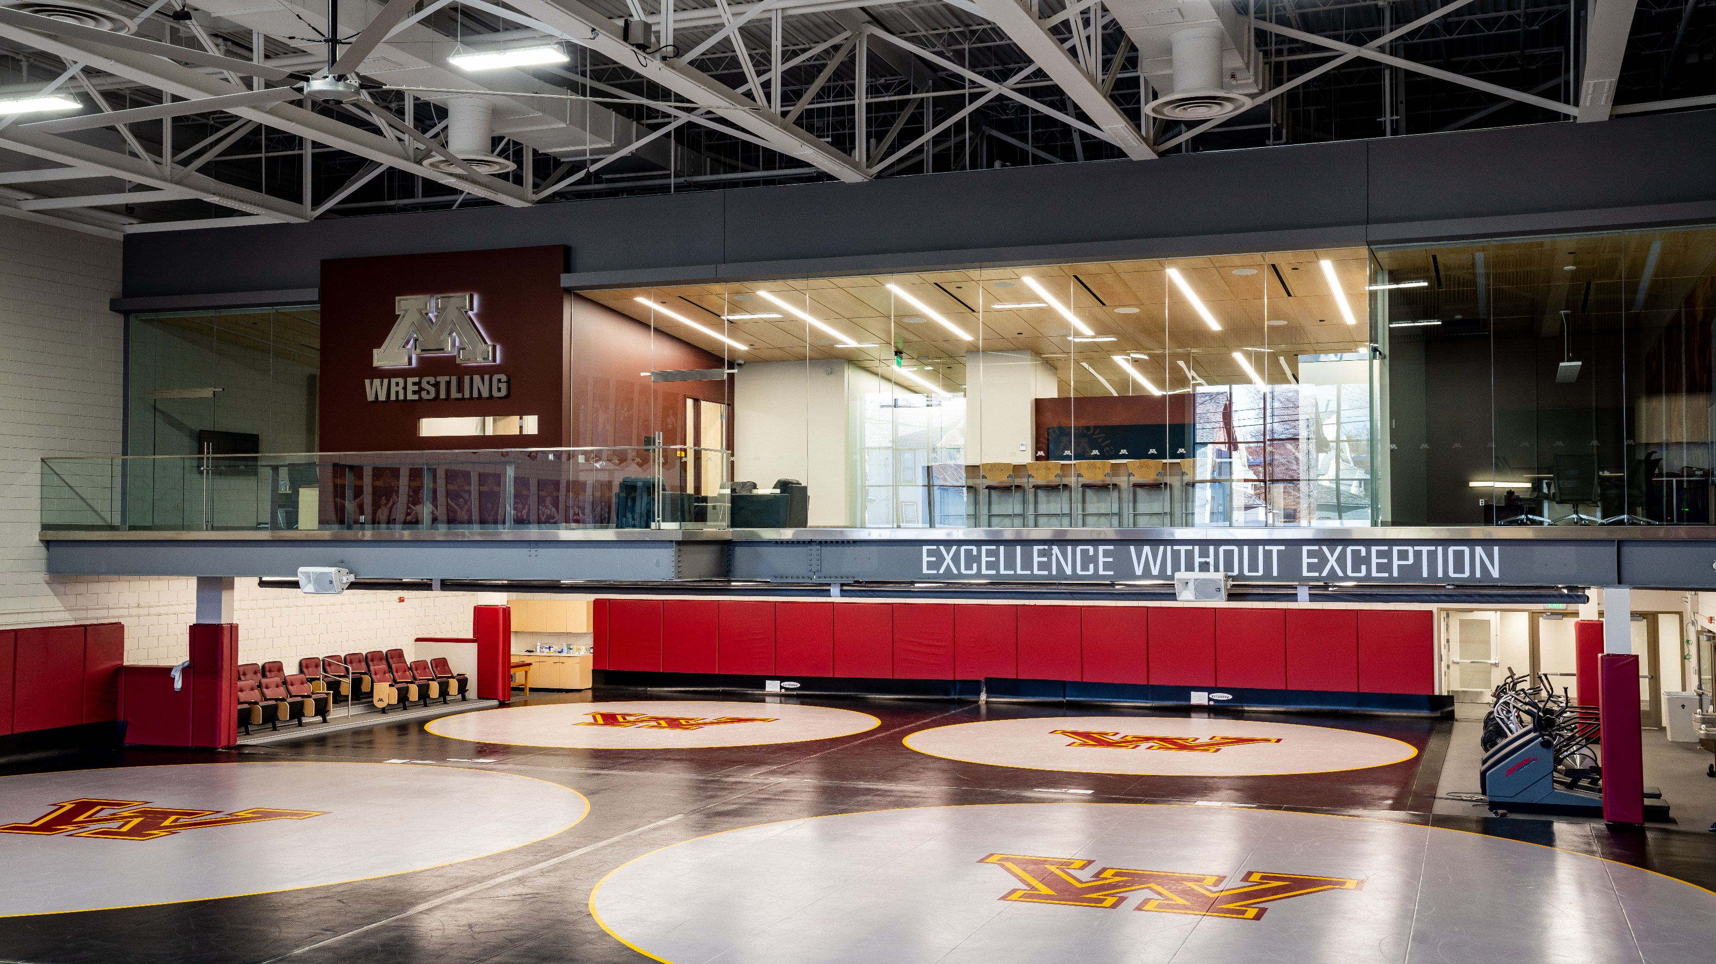
Bright Future
Notes:
I started by talking about the success we’ve had academically and athletically in the past few years. We’re building on that foundation.
Facilities
Athletes Village: transformative, extraordinary but not extravagant. Opened in January, on time and on budget.
Have hosted several events open to the public including an Open House in the spring.
Fundraising going well. Currently at more than $110 million raised (toward $166 million)
Largest single fundraising campaign in department history - $110M+ already dwarfs approx. $83M raised for TCF Bank Stadium, the previous department record
Still need a few more leadership-level gifts to hit our ultimate goal, but with about we are excited with how fundraising is shaping up.
New track and field stadium: walked into a situation where the track and field programs no longer had a home track.
Even prior to the track demolition, it was unfit for college competition and hadn’t hosted a meet in more than a decade.
New track and field stadium opened in September.
First-class, best facility in the upper Midwest. Asset to the entire state’s track and field community.
This academic year have opened new practice facilities for wrestling and men’s and women’s golf, replacing non-existent or badly needed prior practice situations
Looking ahead to facilities upgrades for men’s and women’s gymnastics and volleyball, also.
Coaches
We have one of the best collections of head coaches in the country. Incredible leadership.
Have hired 6 new head coaches in the past two years (Fleck, Whalen, Motzko, Eggum, Trachsel, Thompson)
Young, dynamic energy in coaching staff as a whole (10 of 21 head coaches are 40 or younger)
Staff
Our support staff is incredible throughout our department, particularly in some key areas of our student-athlete experience, which is a critical piece to recruiting top students.
Student-athlete development (life skills, leadership coaching, job placement – all things that will be enhanced by Leadership Center in Athletes Village)
Academic staff (continued growth and success in academics for many years – will have more modern, dramatically expanded space in John and Nancy Lindahl Academic Center)
Compliance staff (providing expert guidance to make sure we’re always trying to do things the right way and within all rules and policies)
Budget
No one ever wants to talk about the budget, but it’s a very real thing in college athletics. We had a lot of budget challenges last year. We have a tight but manageable – and balanced - budget this year. Moving ahead, we will have a sustainable operation budget for our athletics department. We are receiving more money than ever before from the Big Ten, but all the legacy members of the conference are increasing in this way as well. To compete, we need to manage our budget very well, and I feel like we are now in position to do that.

Slide 7
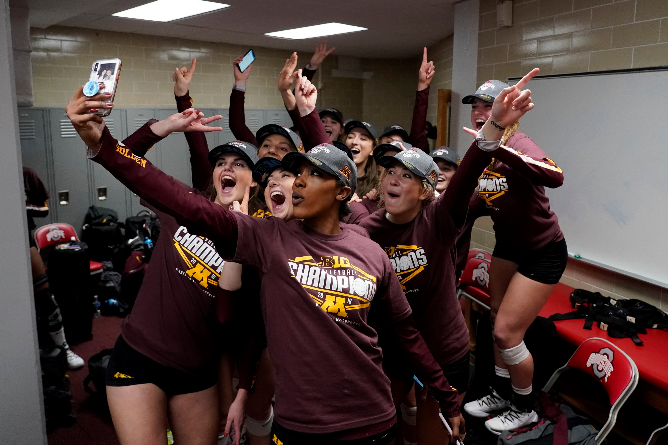
Guiding Principles
Notes:
As we try to establish the culture of our athletics department, we have considered what our principles and core values will be. I say we because this isn’t something I developed, or just my senior staff worked on. We held more than 20 listening sessions over the summer with our staff to learn more about where we need to improve as a department, and what our staff feels we should stand for. That input from our staff evolved this ideas to where they are today.
In developing our guiding principles, there were a few things we always kept in mind:
Everything we do in athletics is sensitive. We are proud to be one of the most visible parts of a world-class university, the state’s flagship institution. We love that our campus isn’t set in your typical sleepy college town, but instead in a vibrant, growing metropolitan area. We get a lot of attention, and that’s a good thing. It also means everything we do is carefully watched, and we must understand that at all times.
We had to eliminate the gap between what we say and what we do.
Doing it right always matters. You can’t always know you’re doing the right thing, but you have to always try to do the right thing.
Changing culture, changing history, is going to take energy, commitment and time. Patience and trust are not things that come in vast supplies – and they both need to be earned - but both are needed in this process.

Slide 8
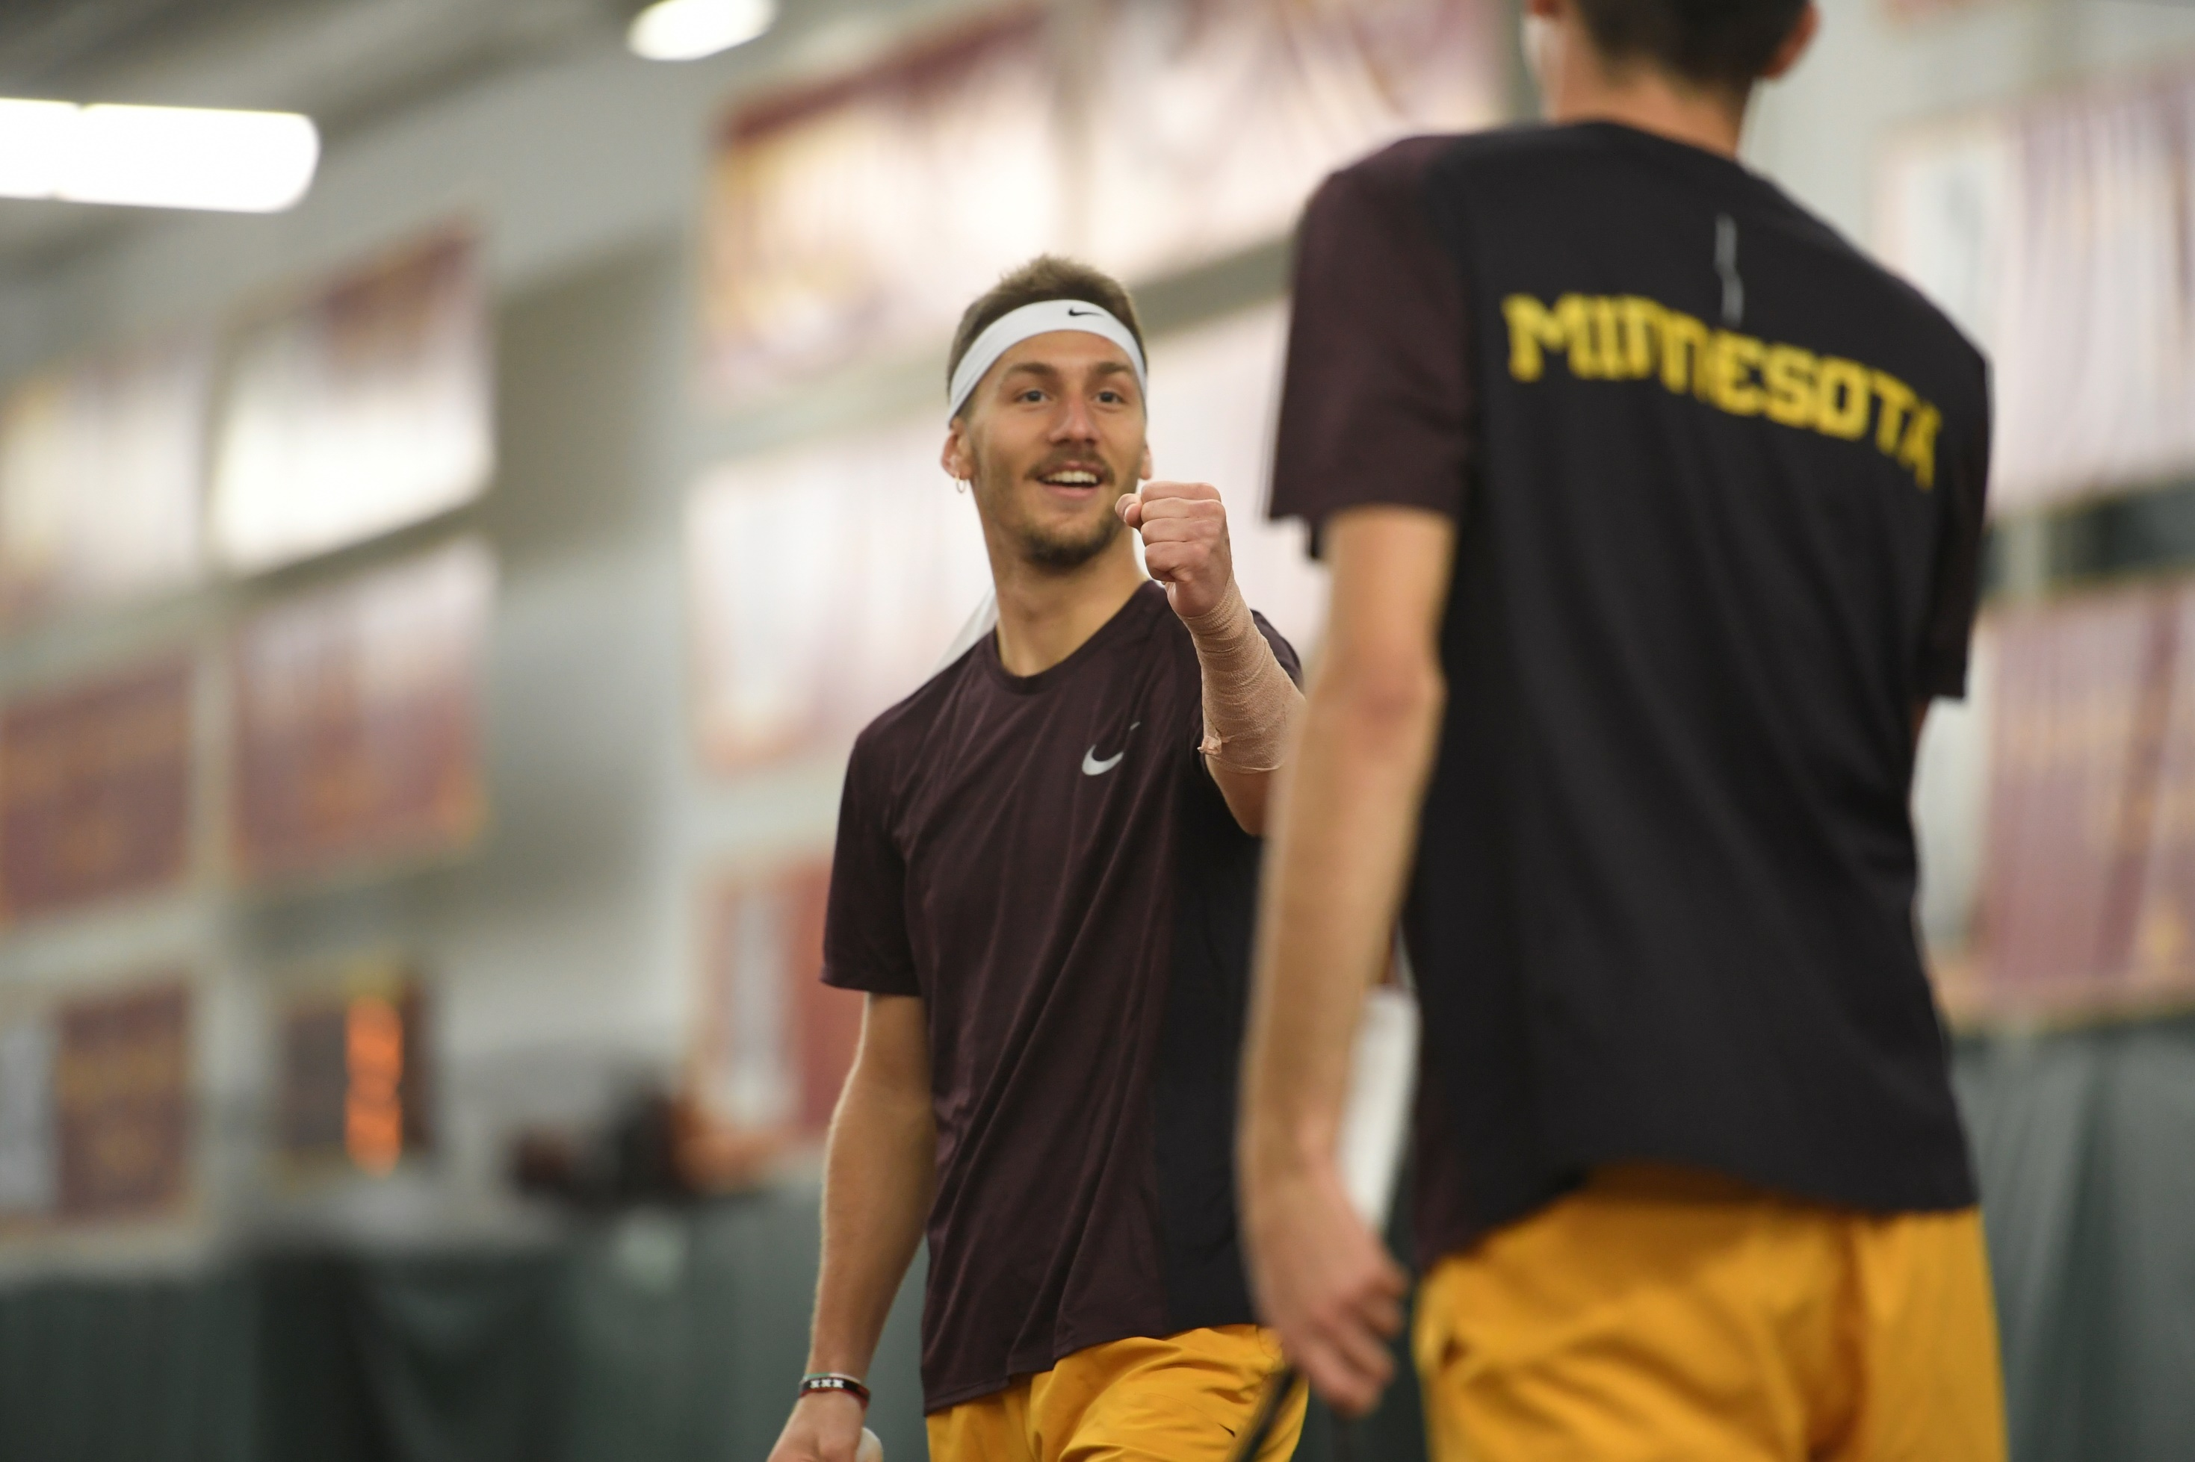
Action | Honesty | Humility | Innovation
Notes:
Action: We value results over promises.
Honesty: We will try to do the right thing every time.
Humility: Low ego; high output
Innovation: Creatively maximize our resources and take calculated risks.
The Gopher Loyalty Program is a great example of innovation. We brought together a collection of fan experiences and benefits and turned the power over to you, allowing season ticket holders and donors to customize your experience with Gopher Athletics. No one else in the country has a program like this – everyone else is still offering donor benefits with a one-size-fits-all approach. Ben Fraser and Mike Wierzbicki deserve a lot of credit for this great program.

Slide 9
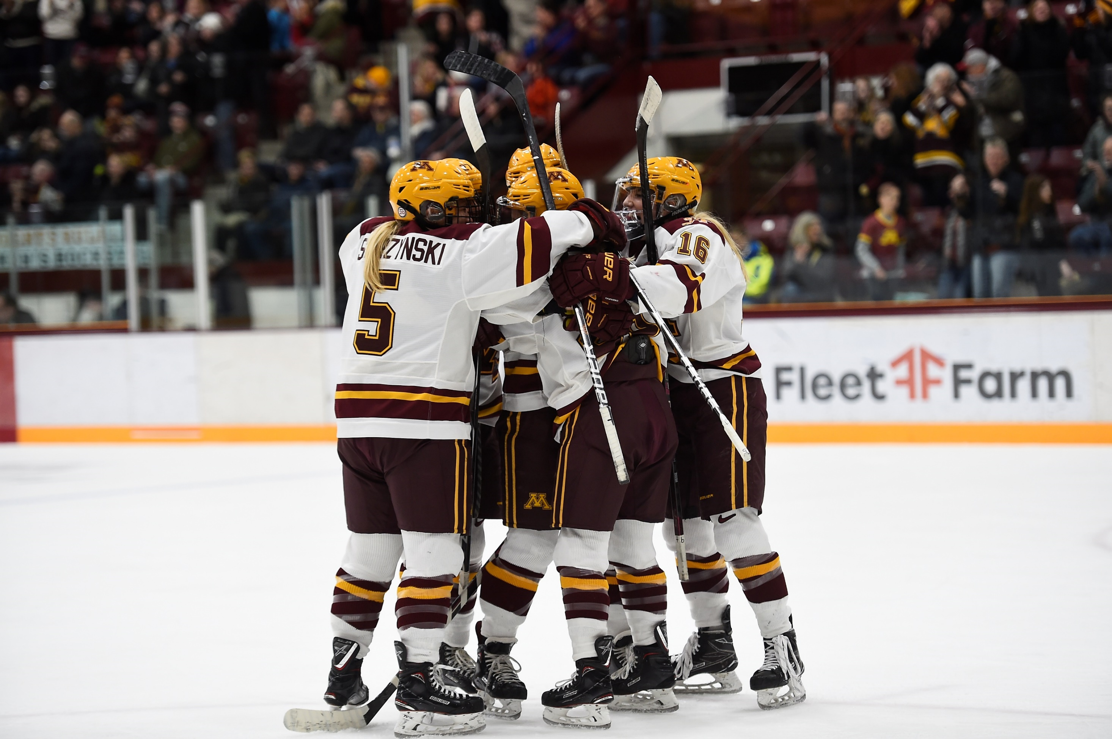
Core Values
Notes:
Just as we did with our guiding principles, we took feedback from our entire staff – again, more than 275 full-time employees – in refining our core values, the things our athletics department wants to exhibit every day. It’s critical to have collective ownership over our organization for us to succeed.

Slide 10
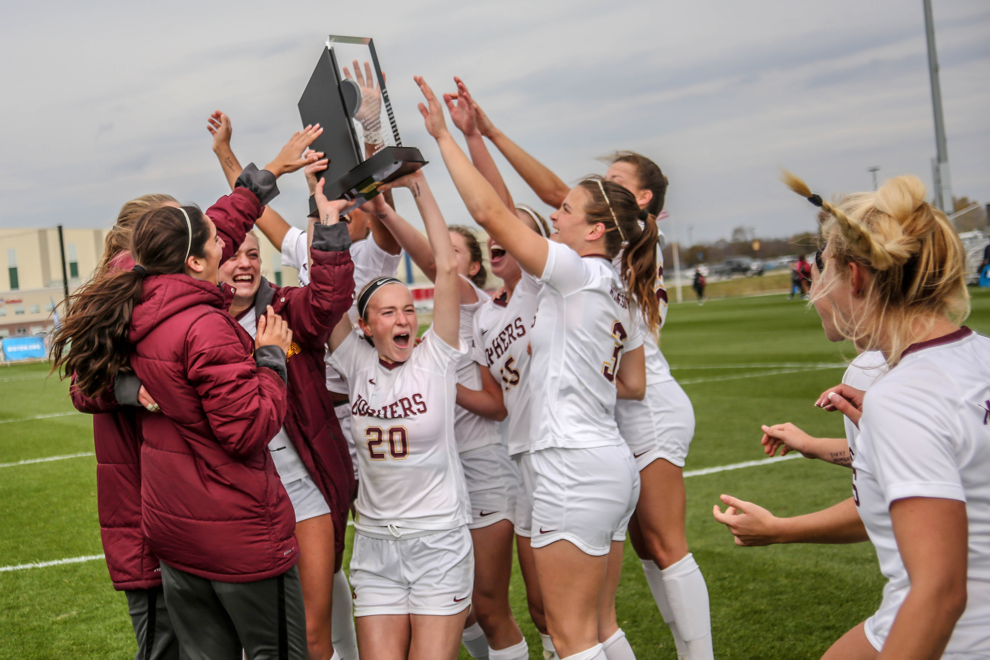
Genuine Care and Concern
Athletic Excellence | Academic Excellence
Embrace Diversity | Authentic Communication

Slide 11
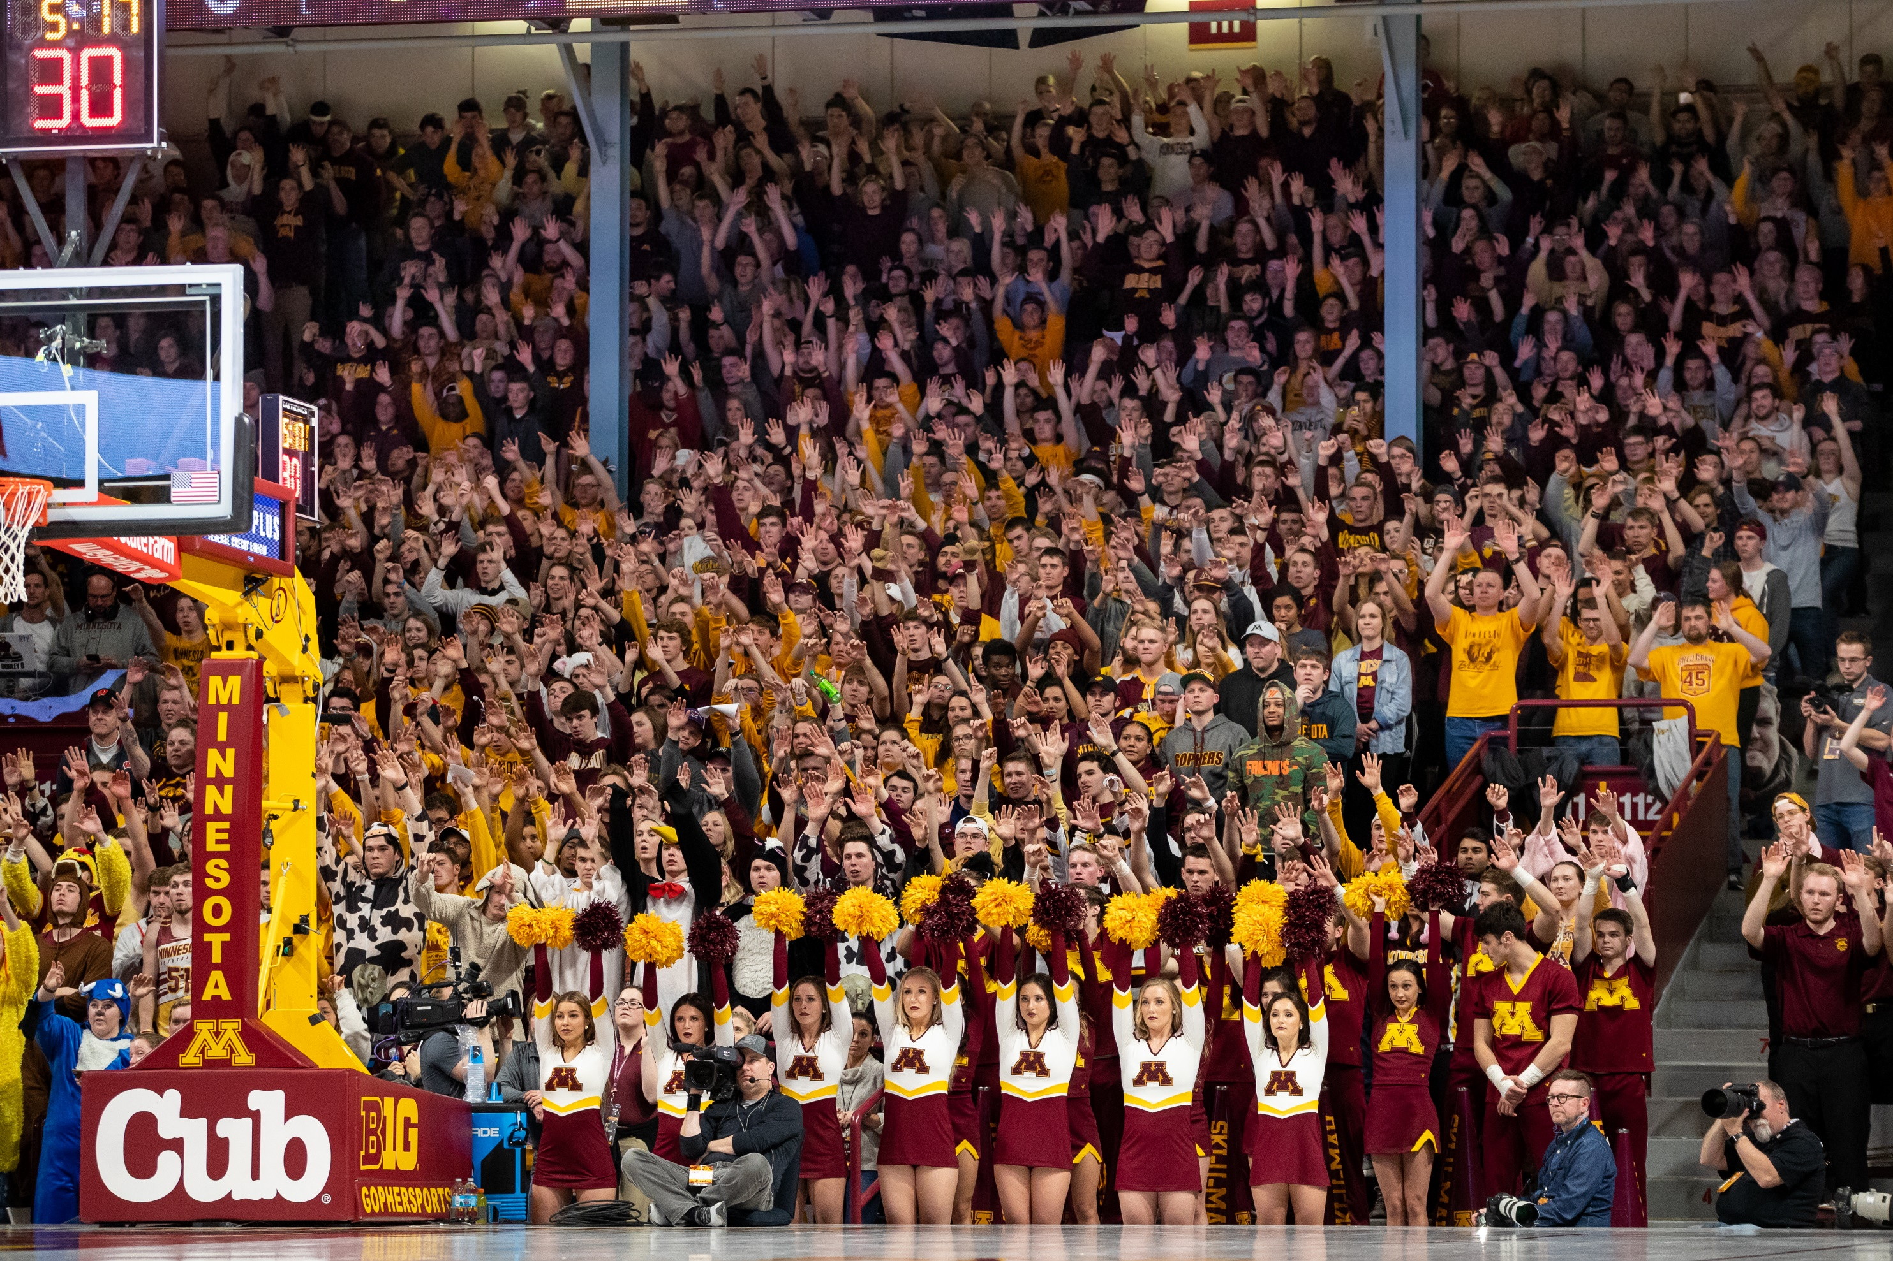
Advocacy | Leadership | Investment
Notes:
The things we have already accomplished have been possible because of all of you, season ticket holders, donors, fans.
To achieve our next goals, to compete at a high level across our department and be our best academically, athletically and socially, we need your support.
We need your advocacy – share positive news about our programs and students on social media, talk about it with your friends and family.
We need your leadership – help us grow our community, introduce new people to our games and events.
We need your investment – buying tickets, contributing to the Golden Gopher Fund, wearing Gopher gear, watching us on TV when we’re away, we need you to continue to invest in us. I always say we want to invest more in each of you, and we’re trying to invest one step at a time. This event today is an example of a small step. This Gopher Loyalty Program that you are all a part of is a big step.
More than anything else, we need you. We know we can accomplish great things, together.

Slide 12
OUR GOPHERS

