Slide 1
Tax Efficient Distributions to Family and Charities Andy Whitman, Chair Finance & Law 09/20/2021 (All errors & opinions are mine.)

Slide 2
Thanks for supporting UMRA and UMN!
John A. Knutson & Co.
Kim Elm/Administrative Assistant,
Todd Koch CPA, MBT, CFP, Partner

Slide 3
An Educational Exercise Contact Your Advisor Specialists Each Area (Please use Chat and write questions in classroom)
Financial Planning-CFP Specialized with Retirees of UMN
Estate Planning – Attorney’s Practice is Estate Planning
Tax Planning & Filing- CPA experienced with Retirees
Advisors take you & your family through the process, & be there when needed
Do not have estate documents drafted by your uncle, a general practitioner. Don’t “do it yourself” Online.
Do not buy insurance with the lowest premium, unless…..

Slide 4
Survey Questions Answered by F&L members.
1. Are you interested in Retirement Account Distributions To Family. So future earnings or sale will have a lower tax bracket?
2. Are you interested in Retirement Account Distributions To Charity?
3. Are you interested in gifts of investments or real estate?
4. Are you interested in how beneficiary designations differ in Roth IRAs, retirement accounts, and non-retirement accounts?

Slide 5
AGENDA
Lower tax rates increase of rates of return.
DISTRIBUTIONS TO FAMILY- GIFTS TO LOWER INCOME TAX PERSONS
MANAGE RMDS Required Minimum Distributions (RMD)
MANAGE QUALIFIED CHARITABLE DISTRIBUTIONS (QCD)
FUNDING ROTH IRAs
USING A DONOR ADVISED ENDOWMENT FUND
PRELUDE TO ESTATE PLANNING & YEAR-END TAX PLANNING WEBINARS

Slide 6
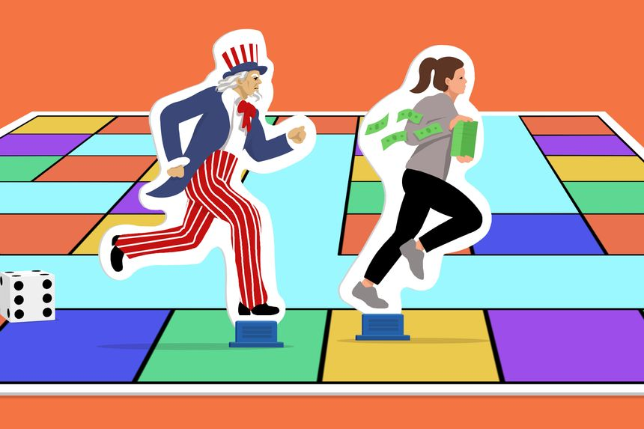
Illustration: Kiersten Essenpreis, Consider making these moves before year-end to stay ahead of Uncle Sam.
Democrats Want to Raise Taxes. Here’s Your To-Do List. Wall Street Journal, Sept. 17, 2021. ( proposed tax changes)

Slide 7
INCOME TAXES IN PERSPECTIVE
(Answers to questions: ”It depends” & “It’s Complex”, the 14th Dalai Lama.)
Added percent mark-up of income tax is 40% average, combined federal and state tax. This webinar is about reducing that tax, risk free.
Retirees do not pay the most regressive charge, the FICA social security “charge”; it redistributes income.
Signal retirees pay more tax than married joint filers. Signal returns give a higher tax with a higher tax rate.
2021 credits provide a “minimum guaranteed” income: Child Tax & Earned income credits; not in future years.

Slide 8
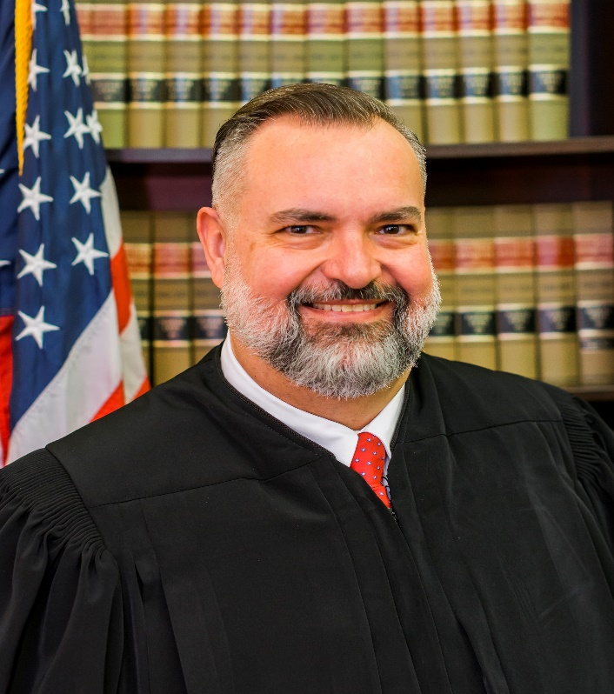
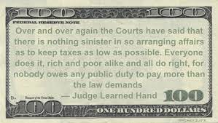
Judge Learned Hand

Slide 9
DISTRIBUTIONS TO FAMILY- GIFTS TO LOWER INCOME TAX PERSONS
Fund Roth IRAs of a Child When the Child Earns Income.
Fund Gifts to Minors, Coverdale Savings, “529 Plans”
Beware of Investment Rankings based on annual
investment returns, check 5 & 10 year.
Home // College Savings 101 // Coverdell ESA // Coverdell ESA providers (At Fidelity site)
Gifts: $15,000 Single & $30,000 Joint are not gift limits.

Slide 10
Key IRA features
IRAs are available to spouses with no current income.
IRAs allow of $7,000 contribution for over age 50 with earned income
IRAs on behalf of minors with earned income.
You might fund a Roth IRA by converting from an IRA to a Roth IRA, and pay income taxes on the conversion.
Self-employed, freelancer, royalties, side-gigs, pay less tax with a SEP IRA. But it is subject to RMD.

Slide 11
MANAGE RMDS (Required Minimum Distributions)
Are RMDs suspended in 2021 as they were in 2020? No.
Calculation of RMDs from All tax deferred accounts; avoid 50% penalties
No RMDs for Roth IRAs, unless they are inherited. IRS rules are complex.
(More in Estate Planning Webinar by Matt Guttman, Attorney, Monday Nov. 8 at 1:30pm – 4:00pm. (CST) Class Room – at 1755 Prior Avenue North, Falcon Heights
https://zoom.us/meeting/register/tJUrcO-vqj8jG9efkszmpLt4Zo-A7BMKOtgp

Slide 12
https://www.fidelity.com/retirement-ira/required-minimum-distribution-faq
Top RMD questions for 2021
If you turn 72 in 2021 and did not turn 70½ on or before 12/31/19, then you will need to begin taking RMDs for the first time this year. Learn more about Required Minimum Distributions.
Active employees over 72 do not have RMDs from that employer’s retirement accounts; but RMDs are due from other university employers.

Slide 13
https://www.fidelity.com/retirement-ira/required-minimum-distribution-faq
Top RMD questions for 2021 (“It’s complex” as said by His Holiness the 14th Dalai Lama.)
Are RMDs suspended in 2021 as they were in 2020? No.
If you turn 72 in 2021 and did not turn 70½ on or before 12/31/19, then you will need to begin taking RMDs for the first time this year. Learn more about Required Minimum Distributions
If I had previously automated my RMDs, do I need to take any action to restart my withdrawal plan?
Do I need to take more than one RMD in 2021 to make up for skipping one in 2020? No.
I received a 1099-R tax form showing an RMD from 2020 that I returned to my IRA before the August 31, 2020 deadline outlined in the CARES Act. Do I need an updated form to reflect that my distribution was redeposited? No. Please consult your accountant or tax advisor on how to reconcile this withdrawal with your 1099-R, 5498.
Can I Roll back the RMD that was taken from my IRA in December of 2020? Yes, 2020 RMD withdrawals were treated as distributions and would be eligible for 60-day rollover treatment. Customers would need to add the Distributed amount back to their December 31, 2020 balance and re-calculate their 2021 RMD.
Can I roll back the RMD for my inherited IRA account that was distributed in December of 2020? No. Withdrawals from a non-spouse beneficiary inherited IRA were only eligible to be rolled back until August 31, 2020, If they were taken prior to that date.
I turned 70½ in 2019 and delayed my RMD until 2020 did I have to take it? No.
If I turned 72 in 2020 do I need to take my first RMD by April 1, 2021? The April 1, 2020 distribution has also been waived. An RMD in this situation would need to come out, for 2021, no later than December 31, 2021.
If I took a CARES act withdrawal in 2020 does it count toward my RMD for 2020, 2021 and 2022? No.
.

Slide 14
Account Types For RMDs RMDs must be taken out of tax-deferred retirement accounts, including:
There are no RMDs for Roth IRAs, unless they are inherited
Traditional IRAs Rollover IRAs SIMPLE IRAs | SEP IRAs Most 401(k) and 403(b) plans

Slide 15
Top RMD questions for 2021 at Fidelity site:
https://www.fidelity.com/retirement-ira/required-minimum-distribution-faq
VALIC/AIG is still paying 4.5%. So take RMD from other lower interest accounts like Securian or TIAA/CREF.

Slide 16
MANAGING QUALIFIED CHARITABLE DISTRIBUTIONS (QCD)
Carefully distribute, document, and inform your tax preparer or you may be taxed on the QCD distribution.
Spouses coordinate QCDs on the Joint tax filing
Tax advantages of processing QCD

Slide 17
Making Qualified Charitable Distributions (QCD)
Carefully document the transfer and tell tax preparer:@020Form 1099-R distribution type (07) “Normal Dist.) Taxable, but tax withheld 0, is the Key.
Distributions to honor: Veterans, Children’s Teams, First Responders; Religion, etc.

Slide 18
Not covering other charitable contribution methods:
Charitable asset gift with income back.
Gifts of appreciated property (but stepped up tax base in deceased’s estate)
Check with Fidelity and UMN Foundation
https://www.fidelity.com/viewpoints/retirement/IRA-things-to-know;
https://give.umn.edu/waystogive
(More in Dec. webinar: Tax Update, by Todd J. Koch, CPA, , CFP / Partner; Wed Dec 8, 2021: Wed. 12:00pm. Register:
https://zoom.us/meeting/register/tJUrcO-vqj8jG9efkszmpLt4Zo-A7BMKOtgp

Slide 19
FUNDING ROTH IRAs
It’s all in Ed Slott and Company, LLC, Book |,https://www.irahelp.com. An action plan to help you make sure your retirement savings aren't depleted by taxes (Not so easy when you are retired.)
Only in person beneficiaries, not a Charity. (More in Estate Planning webinar)

Slide 20
Why consider a Roth conversion now?
What to invest in?
Taxes could rise, making a Roth conversion a timely strategy to consider.
https://www.fidelity.com/learning-center/personal-finance/retirement/answers-to-roth-conversion-questions

Slide 21
USING A DONOR ADVISED ENDOWMENT FUND
Good for yearend tax planning with future charitable distributions
Warning: Distributions do not qualify as RMDs and are not deductible; only contributions are deductible when you Itemize. Fidelity web site:
https://www.fidelitycharitable.org/insights.html?_ga=2.237356480.1568814149.1631481977-1485351185.1561653700

Slide 22
Make your Donation on line or Call Fidelity Retirement: Log in to Fidelity; On “All Accounts” page, Go to search in upper right corner; put in QCD .
Click On: Qualified charitable distributions (QCD) - IRA one-time withdrawal online form
Make a donation to an eligible charity.
From which account do you want to initiate the distribution?
Select your IRA or IRA Rollover account (not a (Roth IRA)
Continue: Name of Charity. Where sent:
charity address? Or yours?
Additional information on check Memo. Don’t put thank for the Teddy Bear or thank for membership, state: “No Goods or Services were exchanged”. Copy the confirmation.

Slide 23
PRELUDE TO ESTATE PLANNING WEBINAR
Beneficiaries: First step in Estate Planning, Designating beneficiaries is important. Your decisions should be made carefully in the context of Estate Plan.
What if you don't designate beneficiaries?
Beneficiary designations or a Living Trust?
Warnings with Transfer at Death by Deed!

Slide 24
Transferring Real Estate, Use a Trust
Real Estate: List the Real Estate in the Trust
Be Sure to Transfer Insurance (Name Donee/Grantee/Buyer as Named insured.
Case of Transfer On Death Deed (TODD))

Slide 25
Court of Appeals opinion, …”that should horrify anyone who has prepared a transfer-on death deed (TODD)” (Article by Sam Calvert, an attorney, Bench and Bar of MN, Vol LXXVIII NUMBER III, March 2021, www.mobar.org. citing, Strope – Robinson v. State Farm Fire & Cas. Co., 8th Circuit Court of Appeals case, No.20-1147 (2/5/2021.

Slide 26
Farm’s Counsel:”…the advice he would give to a client considering executing a TODD would be to contact the insurance provider and try to add their intended Grantee as an additional insured to their correct policy or to advise the Grantee to obtain their own personal coverage independently”.
Courts generally: An insured cannot rely on the “advice” of an insurance agent.
Courts treat agents as sales persons, not advisors, unless the insured paid a fee for advice, or there was total reliance over all insurance, over the years.

Slide 27
PRELUDE TO YEAREND TAX PLANNING WEBINAR
Democrats on the House Ways and Means Committee voted to advance dozens of proposed tax changes. Some tax increases that would raise more than $2 trillion of revenue to help fund the party’s priorities.
TAX PREPARATION ORGANIZATIONS
Prepare & Prosper (P + P) and AARP Tax-aide
Are you eligible, within scope?
P+P tax prep: can handle most tax situations, but some things are out of scope, which you can check out in this IRS article.

Slide 28
Check out our volunteer gigs:
https://prepareandprosper.org/volunteer/
Where tax and money geeks unite! When you volunteer, you’re giving back but you’re also getting in return. Meet like-minded people who love talking taxes and money, learn the nitty gritty through our high-quality trainings, join us for social events, and be a part of a team of geeks who are changing the world

Slide 29
Thanks for Supporting UMRA and UMN!
John A. Knutson & Co.
Kim Elm/Administrative Assistant,
Todd Koch CPA, MBT, CFP, Partner
Questions sent to me will help me fill in the written summary that will go with the webinar recording.
Please send to me questions and suggestions: awhitman@umn.edu; or 612-747-6015.

Slide 30
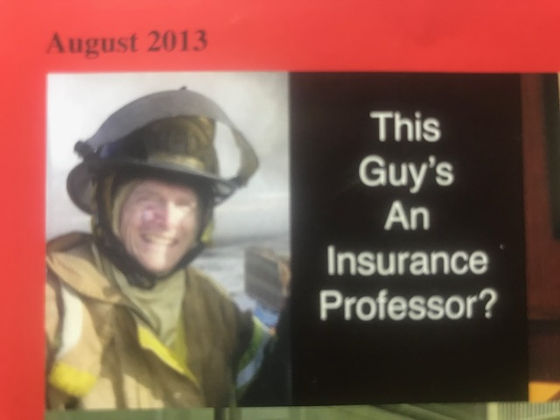
Please send to me questions and suggestions on any topic in the outline. awhitman@umn.edu; or 612-747-6015.
We feel the pain of the 09/11-2001 terrorist attack, current pandemic, wild fires, hurricanes and draught. We will hopefully unite as “A Force for the Good of All Humanity. “A force for Good" is CSOM’s Mantra.

